Slide 1
Bridging research and operations: SPC interactions and field experiments
Dr. Michael Coniglio (FRDD)
February 25–27, 2015
National Weather Center
Norman, Oklahoma
Notes:
Thank you (?)…
…So, we just heard about the R2O work being done within the HWT....

Slide 2
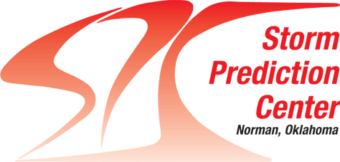
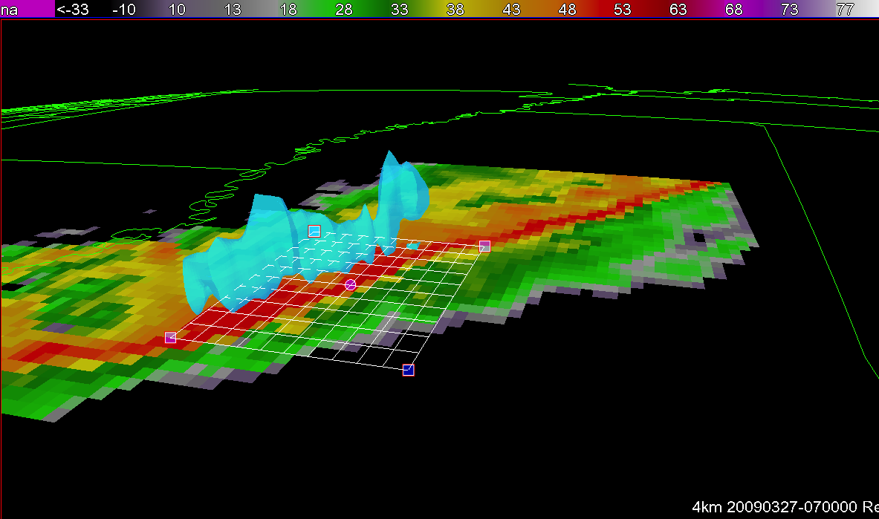
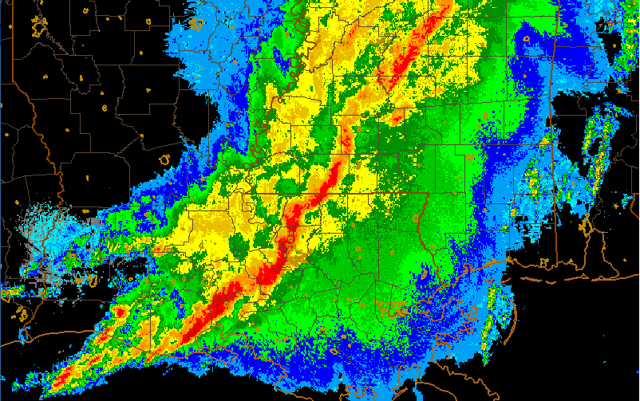
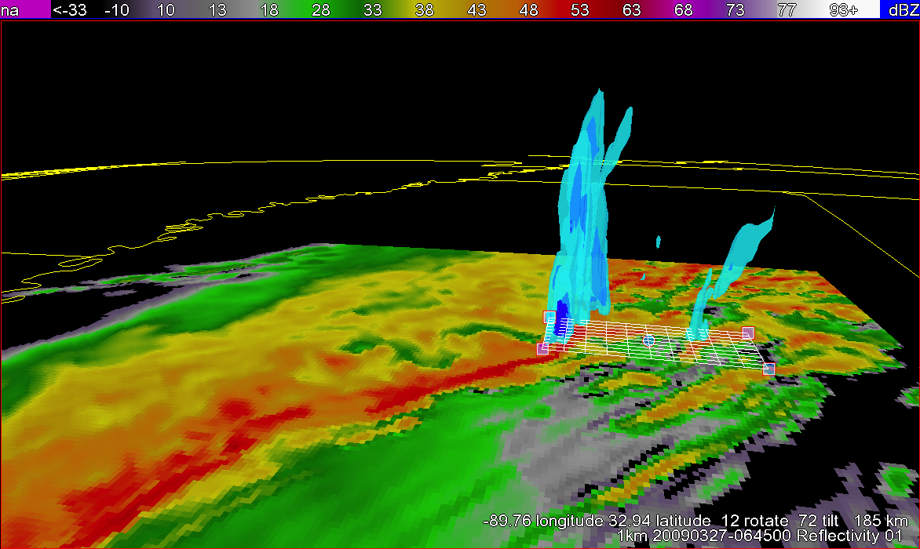
non-HWT collaborations with forecasters
Many behind-the-scenes collaborations outside the HWT within NSSL
Example: Forecast model behavior during cold-season nocturnal tornadoes
Hard to distinguish from null events…difficult problem for SPC
Model forecast
Observed radar 1:15am
4-km grid
Ariel Cohen
SPC forecaster/formerly NWS Jackson, MS
300 miles
line of storms, but no storm here
strong (EF-3) tornado, 20 injuries
1-km grid
high-resolution needed to capture tornadic storm at night
storm w/column of rotation (blue)
NSSL Lab Review Feb 25–27, 2015
Notes:
…I’ll be talking about some of the many behind the scenes collaborations with forecasters that occur outside of the HWT..
…A recent example one I was involved in with SPC forecaster Ariel Cohen on forecast model behavior during cold-season nocturnal tornadoes.
…the motivation is that the conditions that distinguish these particular events from non-severe storms, making this a difficult problem for SPC
…so take for example a radar image of an event over LA and MS, showing a large line of severe thunderstorms over 300 miles long….
…but it turns out the storm that caused the most damage was this tiny cell out ahead of the line that produced a strong tornado and 20 injuries
…As we saw from Adam’s talk, forecasters now routinely rely on numerical model depictions of storm with model grid lengths as low as 3 to 4-km, but for this case…
…. here’s a 3D view of the model depicting the large line of storms, but not the storm that occurred ahead of the line that caused the most damage…
…It turns out that for these types of cases, we may need to go to much finer grid spacing, maybe as low as 1-km, to depict these dangerous rotating storms that often occur ahead of the line of storms in these environments.

Slide 3
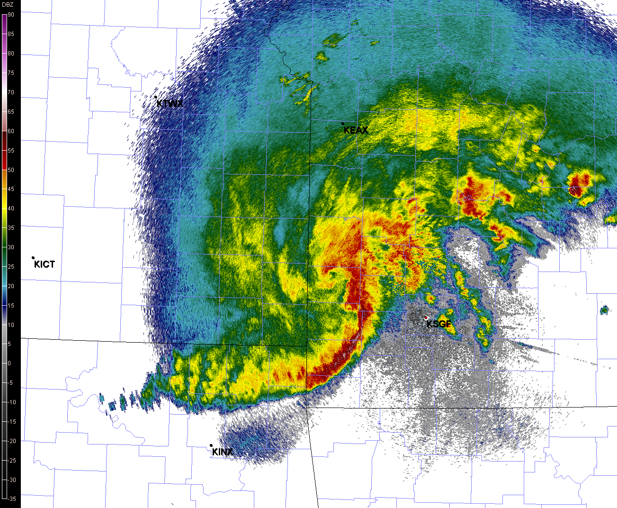
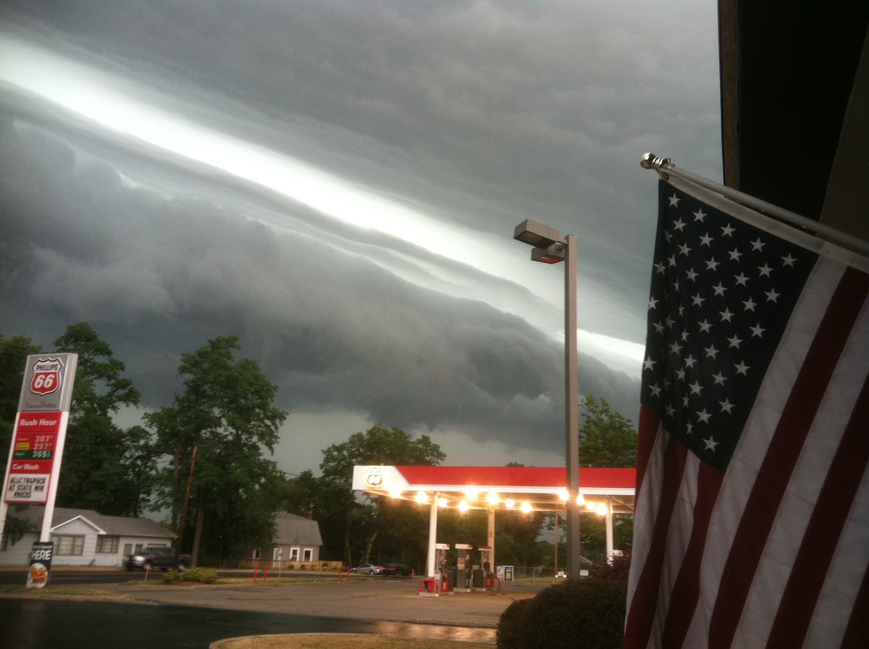
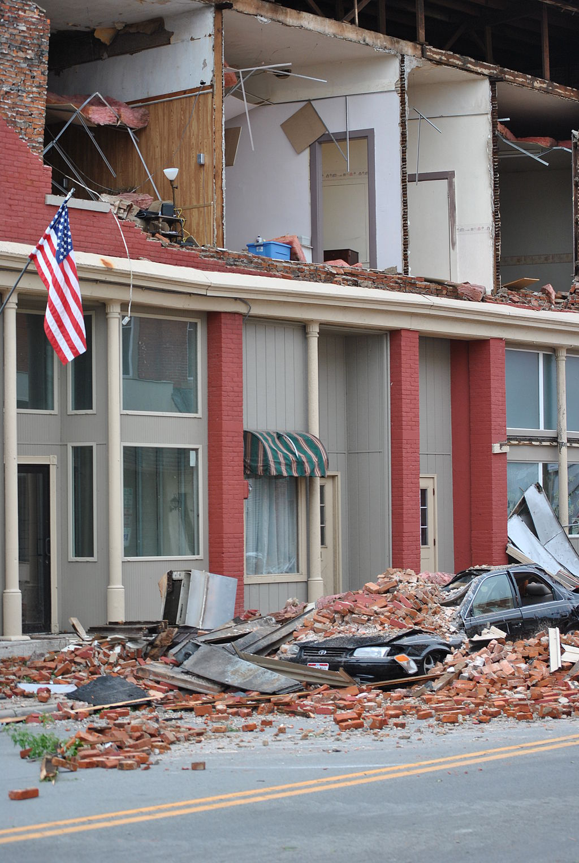
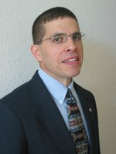
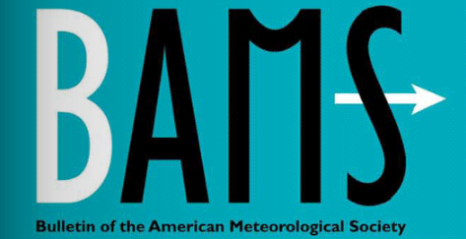
non-HWT collaborations with forecasters
Studies of storm systems that produce non-tornadic high winds and Derechos
June 29, 2012 Derecho
Media confusion & outdated definition led to Steve Corfidi and NSSL to propose new derecho definition
12 pm
severe weather reports (wind, hail, tornado
- very high wind)
12 am
Steve Corfidi, SPC lead forecaster
limit to very long-lived, large storm systems w/internal jet streams, bowing leading edge
June 12-13, 2013 “Derecho”?
Is this a “Derecho”?
How about this?
Aided by Steve’s 30+ years of operational forecasting and many years of research on derechos,
incl. three NSSL-led publications on derechos and storm systems w/SPC collaboration since 2009
Derecho definition last refined 30 years ago, but our reporting and radar networks are much improved….
too many storm systems could be called derechos
Notes:
….NSSL and SPC have also been collaborating on the topic of storm systems that produce non-tornadic high winds and a particularly strong, long-lived subset of those events known as derechos.
……For example there was a derecho on June 29, 2012 that you may have heard about….
….this plot shows the reach that these events can have with all of the blue dots and black squares showing damaging wind reports covering a multi-state area over a short period of time…
….now partly because it impacted the Wash. D.C/Baltimore areas, this event pushed the word derecho into the public eye far more than it had been before ...
…but some media and even those in our community were confused about subsequent events and whether or not they should be called derechos.
So we looked at this, and the derecho definition was last refined 30 years ago, but our severe weather reporting and radar network is much improved, an applying the old definition with newer data allowed for too many storm systems to be considered derechos.
So, because of this, I worked with SPC veteran forecaster Steve Corfidi to propose a new derecho definition to be disseminated in the Bulletin of our largest professional society..
…In general we proposed that derechos should be limited to the very long-lived, large storm systems with particular dynamics, like internal jet streams and bowing leading edges, that are easily identified by our modern radars, like seen in this radar image up here.
….I think this proposal will have weight to it because of Steve’s 30+ years of operational forecasting experience and also many years of research on these events…
…including work that led to 3 publications on derechos and storms systems since 2009, and many more prior to that.

Slide 4
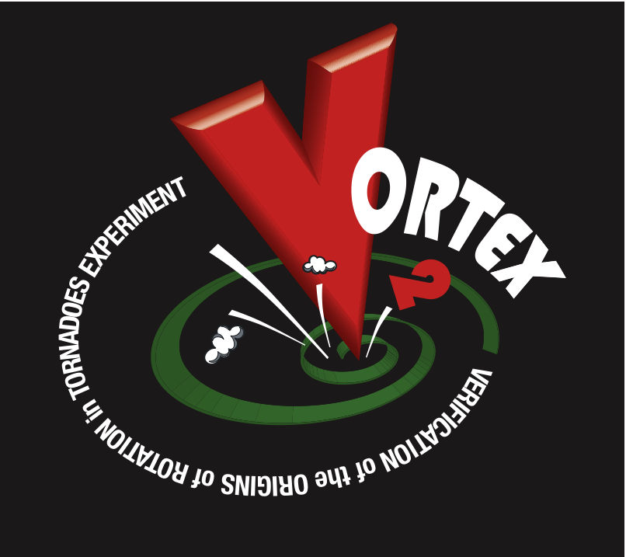
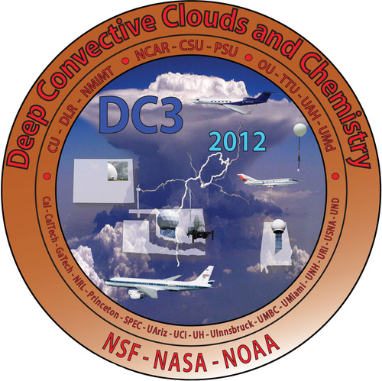
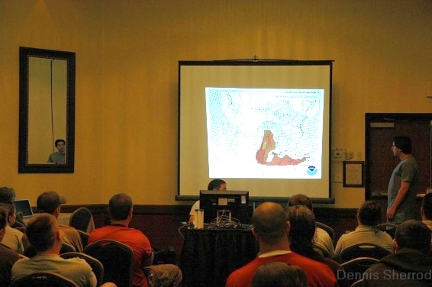
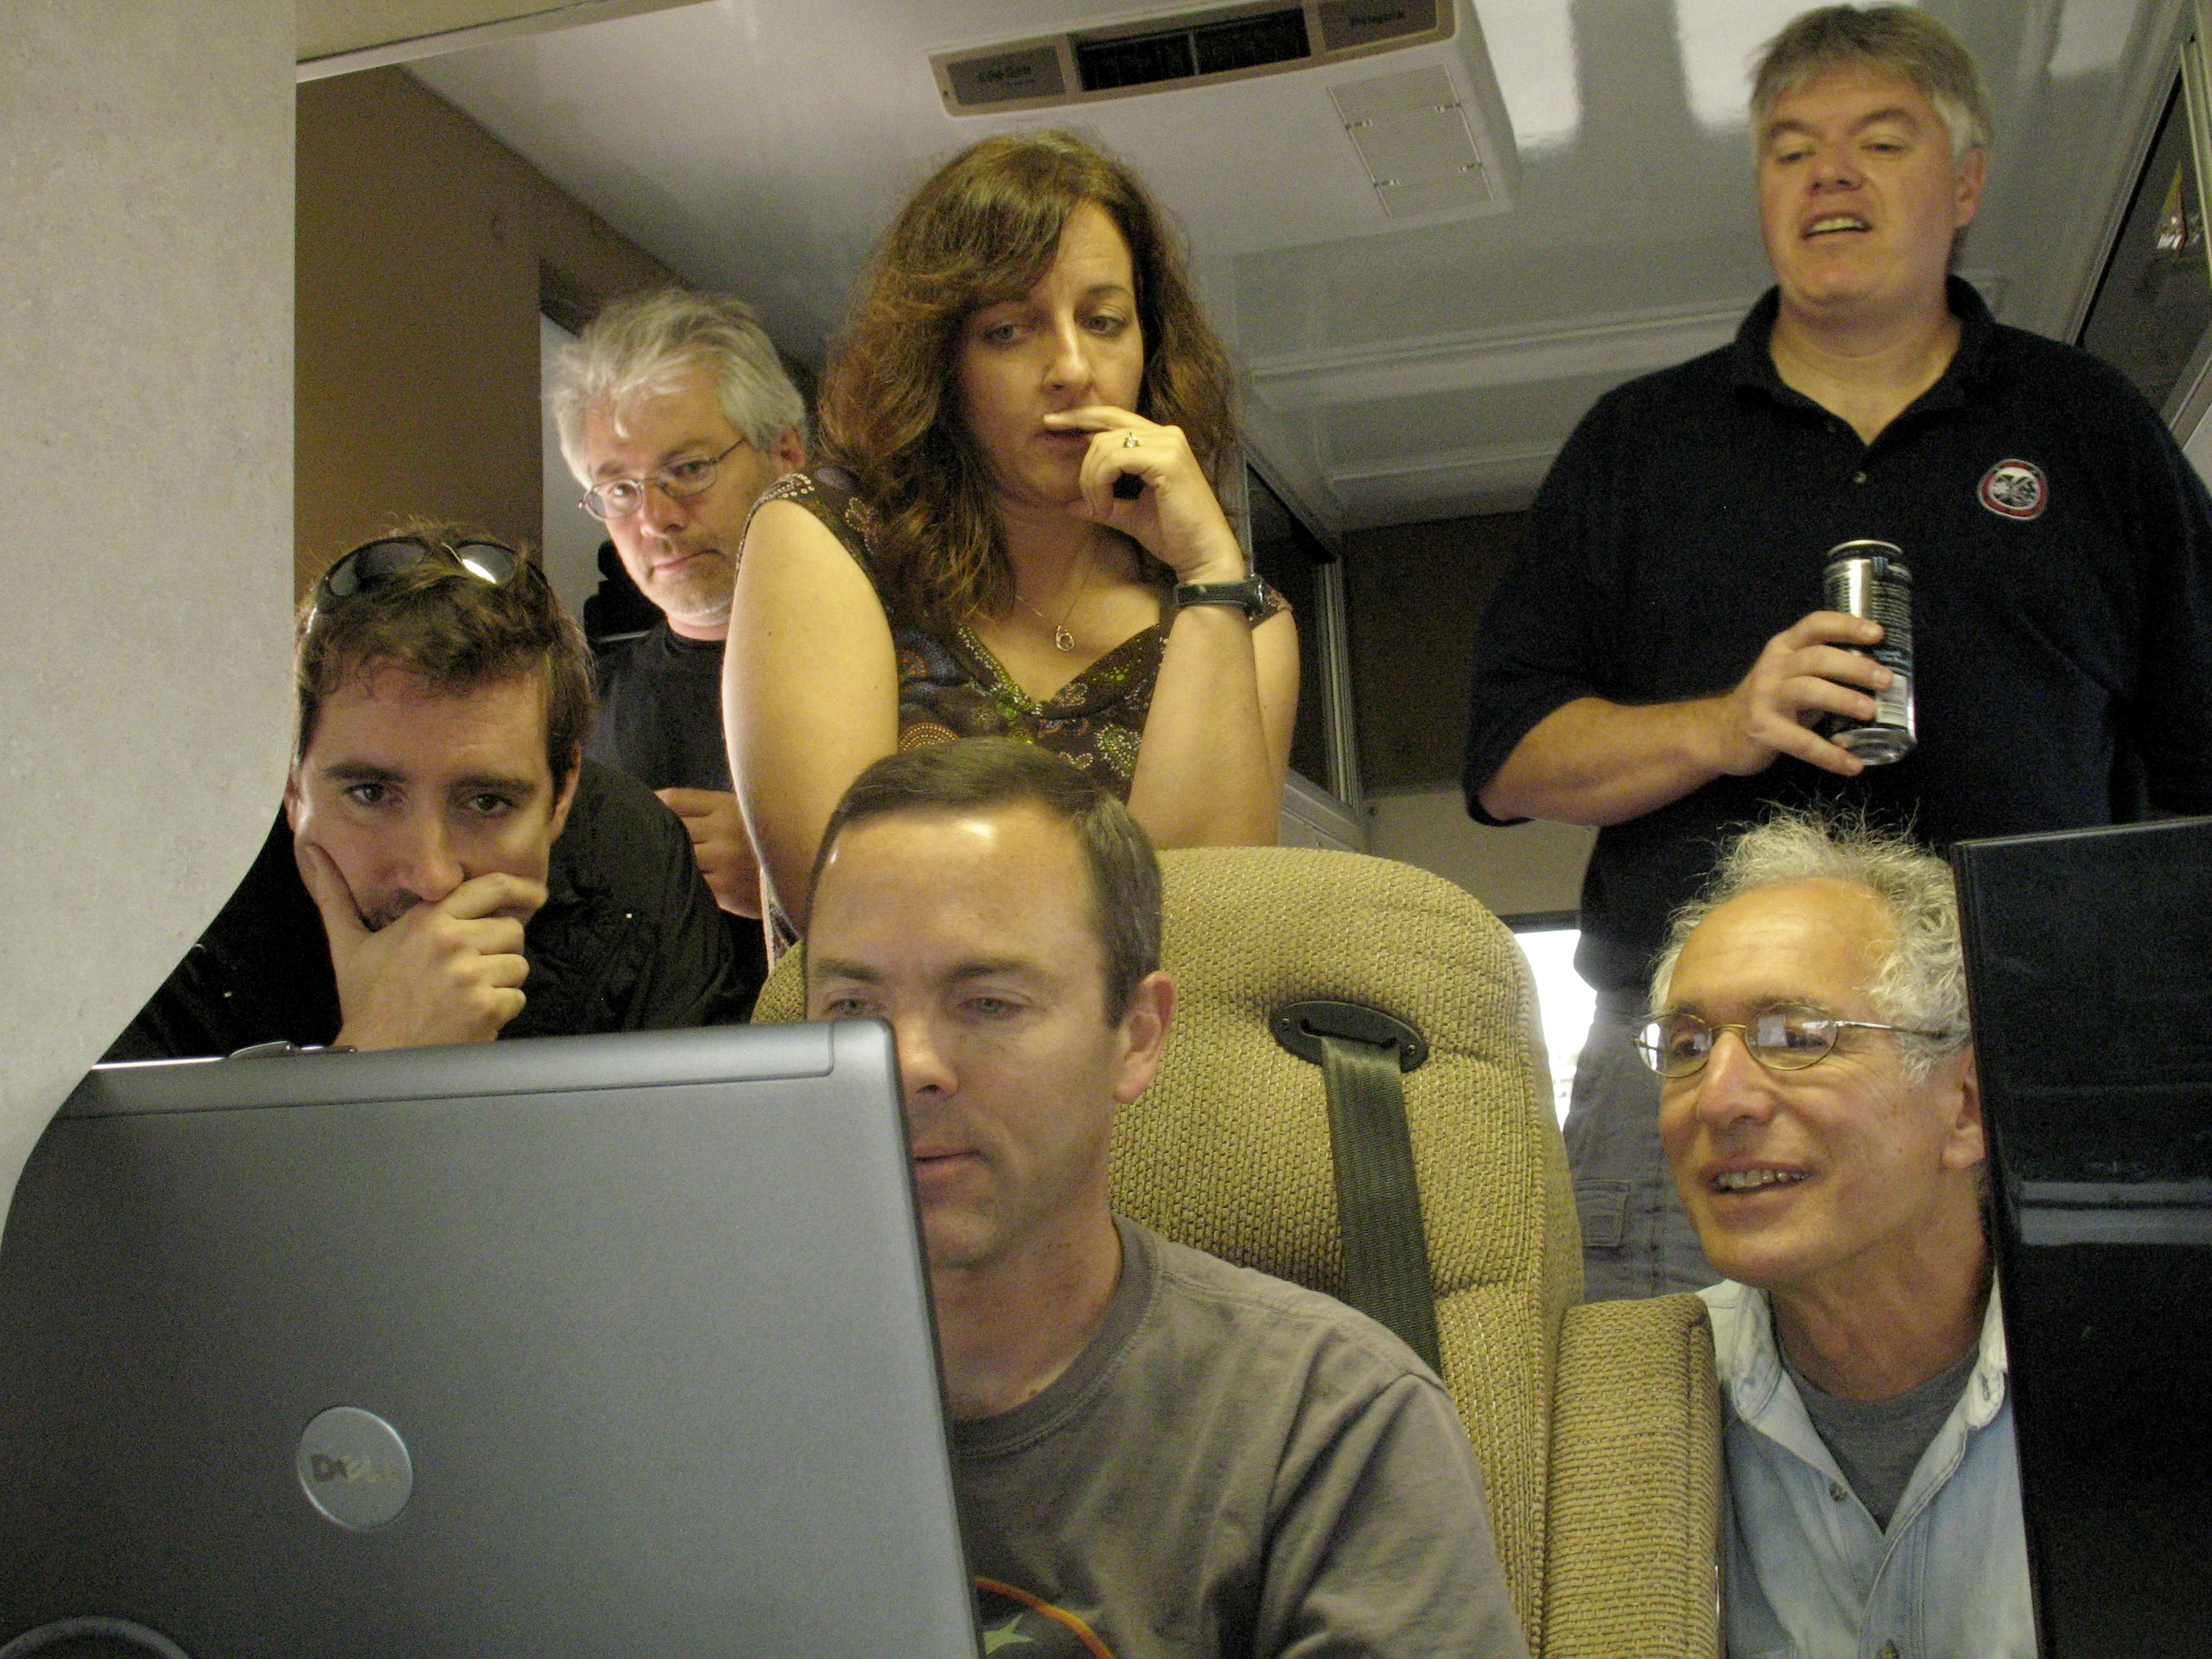
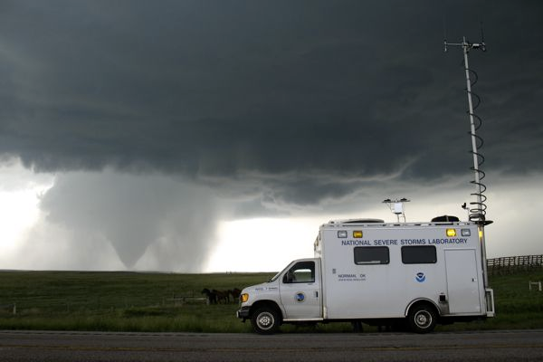
Major Field Programs since 2009
Two expert SPC forecasters (recently retired) will lead forecast operations in the field, one an HWT facilitator
Field Programs are vehicles for O2R- experimental methods tested in HWT applied to field operations.
A VORTEX2 morning forecast briefing
A VORTEX2 meeting in the field to refine targeting
long-range forecasts of probability of rotating storms
short-range forecasts of strongly-rotating storms
These forecasts far from perfect- our experience developing products important in their operational application
Notes:
….So those we’re examples of some one-on-one R2O and O2R activities, but a larger O2R activity involves field programs.
And I bring this up in this talk because field programs are vehicles for O2R, in that experimental methods tested in HWT activities have been applied to field operations.
For example, in 2009-2010 there was a major field program to study tornadoes and rotating thunderstorms, or supercells, called VORTEX2…
…and at that time we were testing products like model probabilities of rotating storms and explicitly predicted tracks of rotating storms like shown here…
…and what we did is we brought this output into the morning forecast briefings and even into mobile facilities in the field to help with targeting decisions.
Now, these forecasts were far from perfect at the time, and continue that way today, so our experience developing these products in the HWT was important in using them effectively in an operational capacity.
….and I should mention that the success of these activities led to the leaders of the upcoming PECAN project to hire two expert SPC forecasters, including one who’s been an HWT facilitator the last three years, to help lead forecast operations in the field.

Slide 5
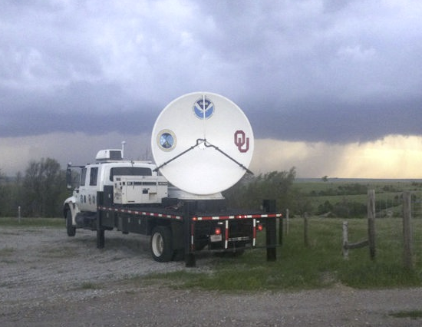
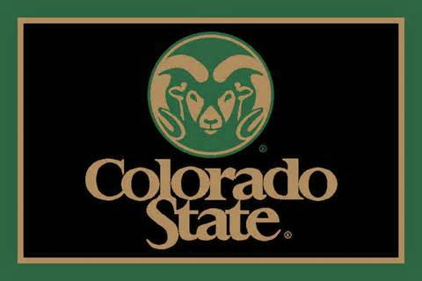
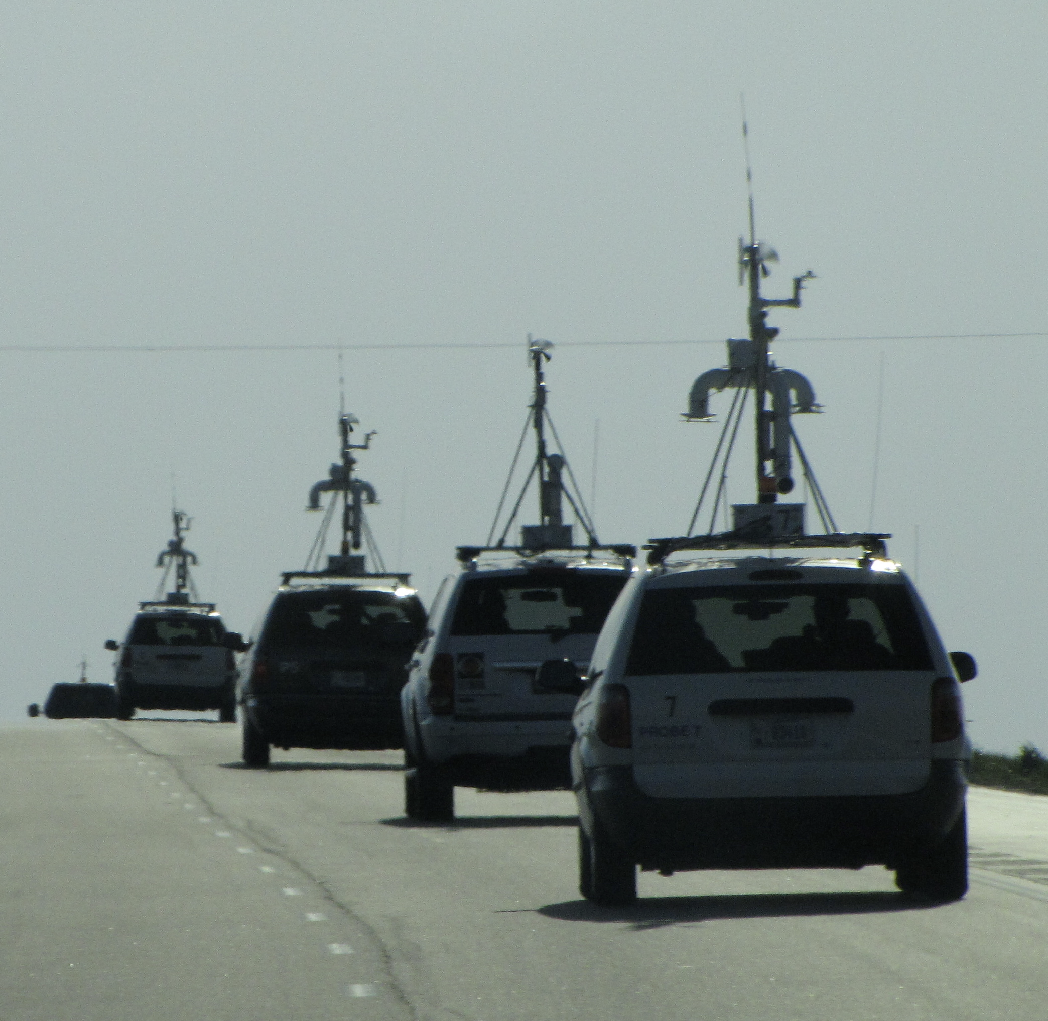
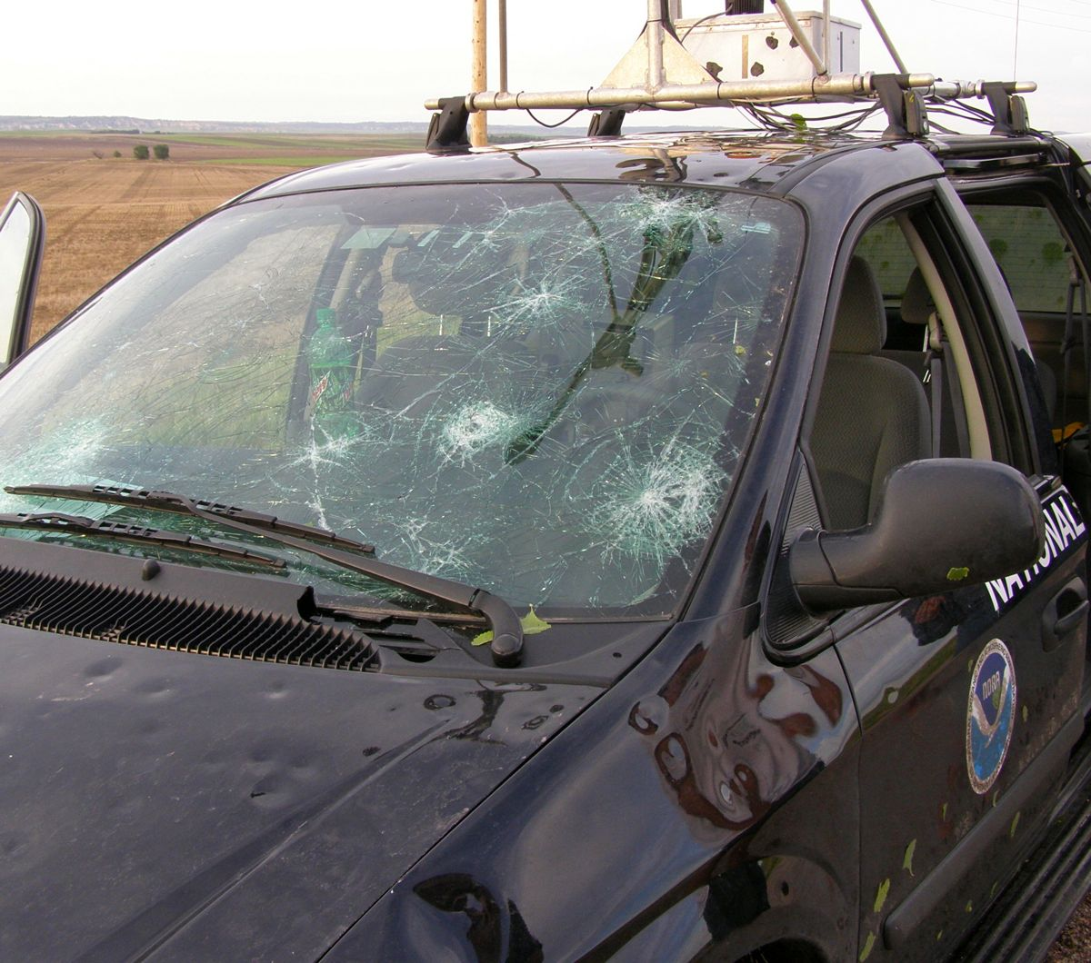
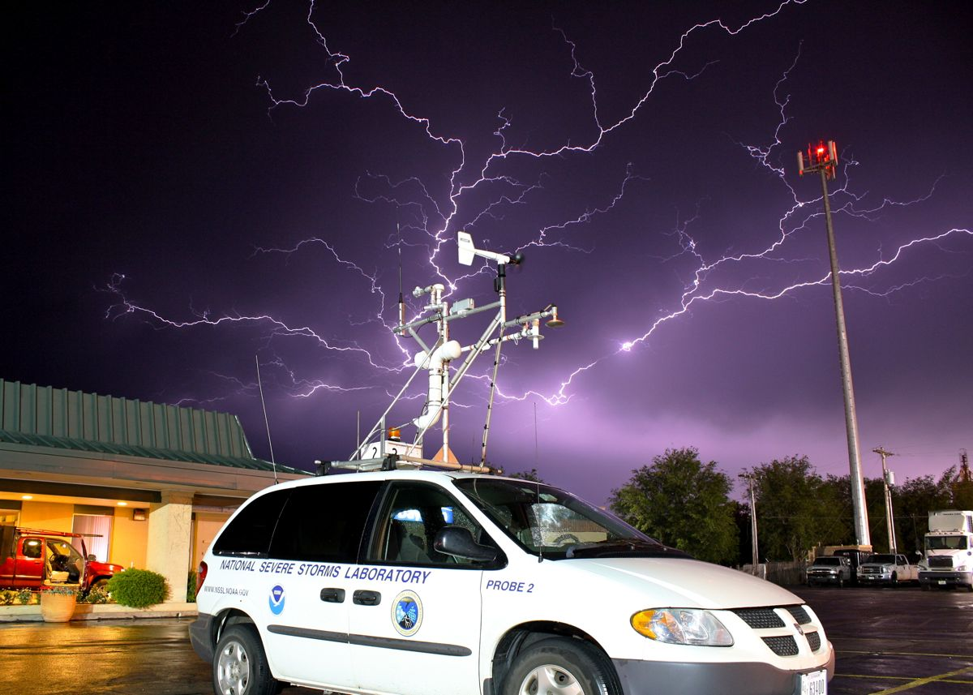
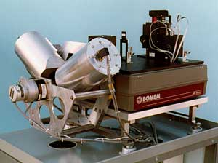
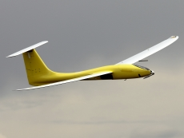
Field Programs: Vehicles for direct collaboration with universities other than
mobile radars (NOXP, SMART-Rs)
mobile mesonets
lightning research
balloon-borne instruments from mobile facilities
unmanned aerial systems
mobile profiling systems
Reach of O2R activities in field campaigns is broad across the community
Notes:
Now NSSL has a long history of collaboration with OU, but field programs are important because they are vehicles for direct collaboration with other Universities…
For example, through VORTEX2, NSSL worked with Penn State in developing and operating mobile instrument platforms called mobile mesonets, as well as sparked an interest with Colorado on unmanned aerial systems, a collaboration that continues today.
And there are others like work on lightning mapping arrays with Texas Tech during the DC3 project, work with CSU, Purdue, and Texas A&M on developing and operating mobile facilities to launch weather balloons near storms in MPEX, which will continue this year in PECAN…
…and there’s a collaboration between NSSL and UAH, and UW in PECAN on mobile profiling systems like those that Dave Turner talked about earlier..
….and the bottom line here is the reach of this type of O2R activity is broad across the community because of the reach that field programs have…

Slide 6
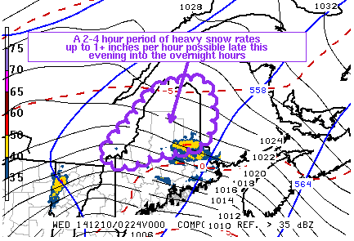
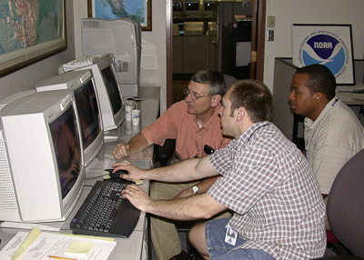
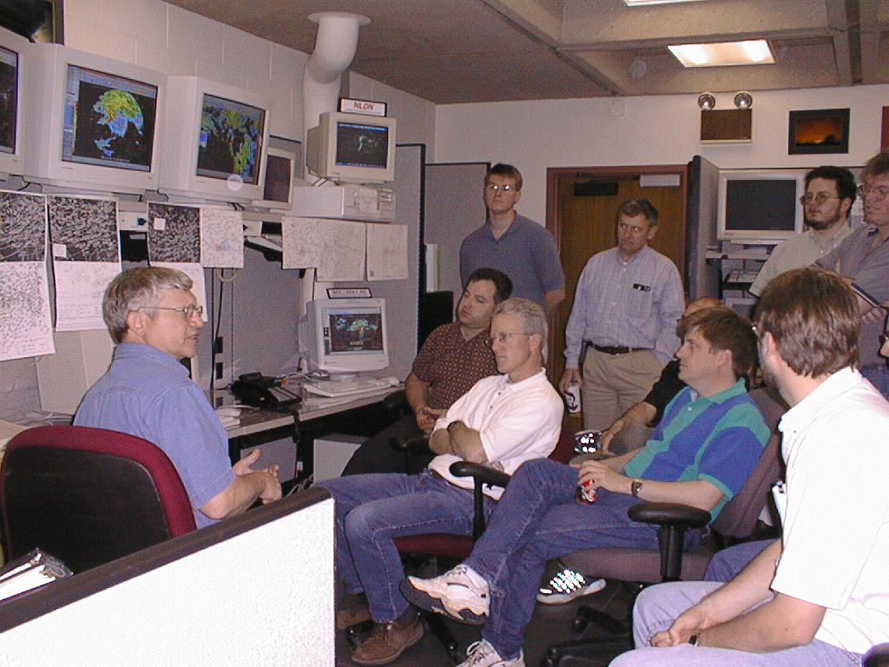
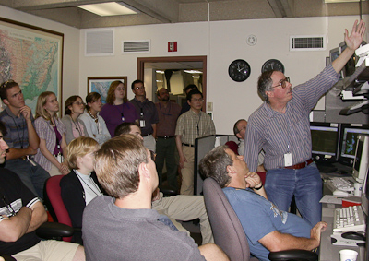
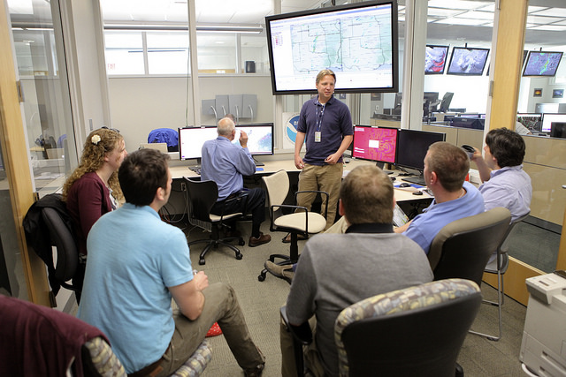
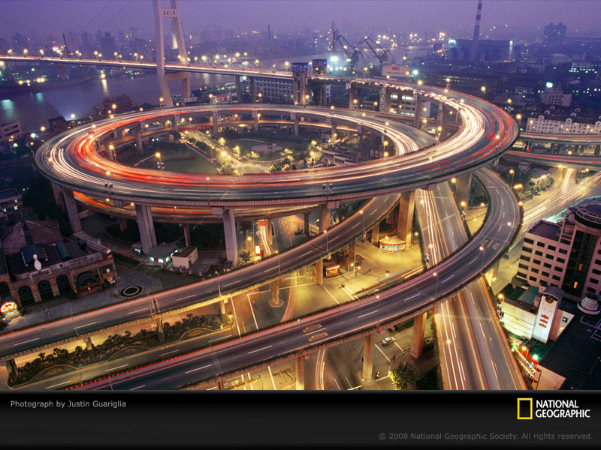
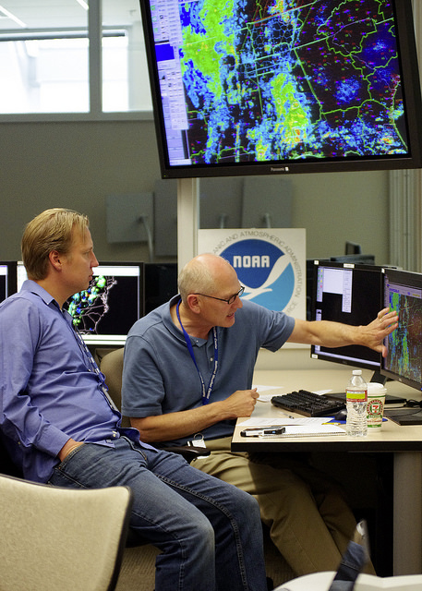
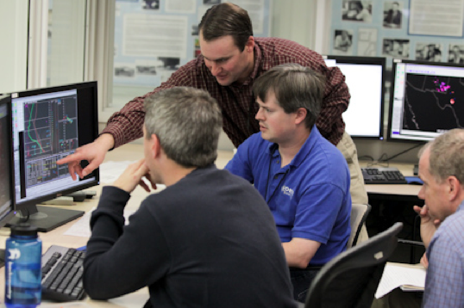
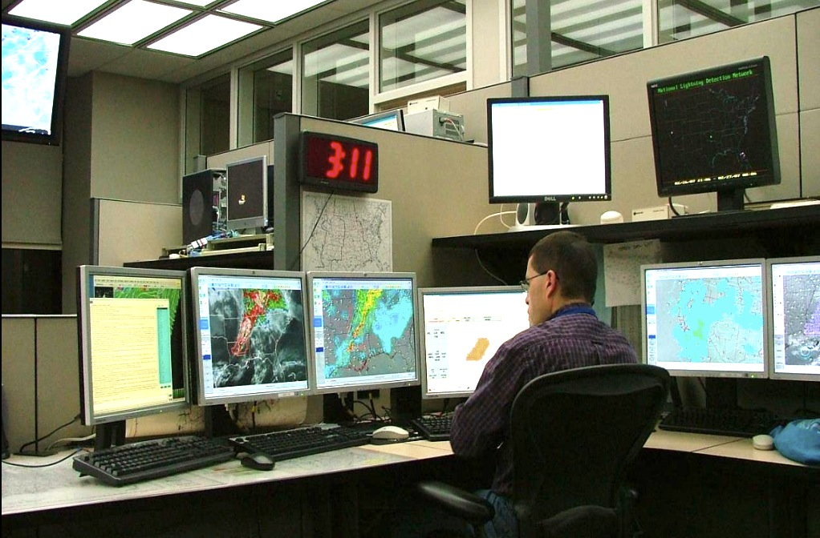
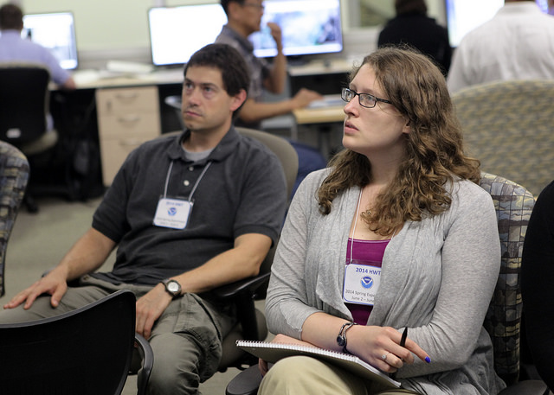
Future: New NSSL/SPC initiative
NSSL scientists work operational shifts, issue real products
Direct conduit for R20 O2R activities
2 - 4 shifts/month (day or evening shifts)
Enhanced Thunderstorm Outlooks and Mesoscale Discussions
Collocation of NSSL and SPC essential, but…
Years of successful collaboration w/SPC, NSSL, HWT were needed…led to culture change and trust to make this happen
Notes:
Now, finally, I want to briefly talk about an outgrowth of all the R20 activities we’ve heard about, which is a new initiative for NSSL scientists to work SPC operational shifts and issue real products….
This is intended as a direct conduit to operations for R2O and O2R activities.
There’ll be 2 – 4 shifts per month, only day and evening shifts (no midnights, thankfully), and we’ll be issuing the “Enhanced Thunder Outlooks” and “Mesoscale Discussions”, an example of which I contributed to is shown here, for a heavy snow event in northern Maine last December.
So, I want to end with noting that the collocation of NSSL and SPC was essential to make this happen, but just the physical merging wasn’t enough…
….Really it took many years of successful collaboration w/SPC, NSSL through the HWT and other means to lead to a culture change and trust on both sides to make this happen, and we’re excited to see the new insights this may provide to both the operational side and to us researchers.

Slide 7
Summary
Successes
Collaboration w/operations has facilitated applied science & research (O2R):
cold-season tornadoes in the southeast U.S.
non-tornadic high wind events & derechos
application of experimental forecasting technique & guidance to field program operations
NSSL scientists now working operational shifts at SPC
Remaining challenges
Maintain these bridges (NOAA to continue to foster collaborative research between forecasters and researchers when topics of mutual interest arise)
O2R (incl. forecaster involvement in research) important in transition process

