Slide 1
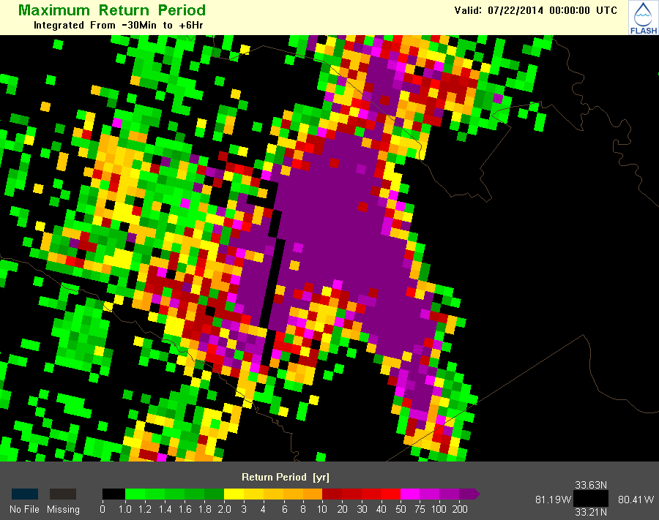
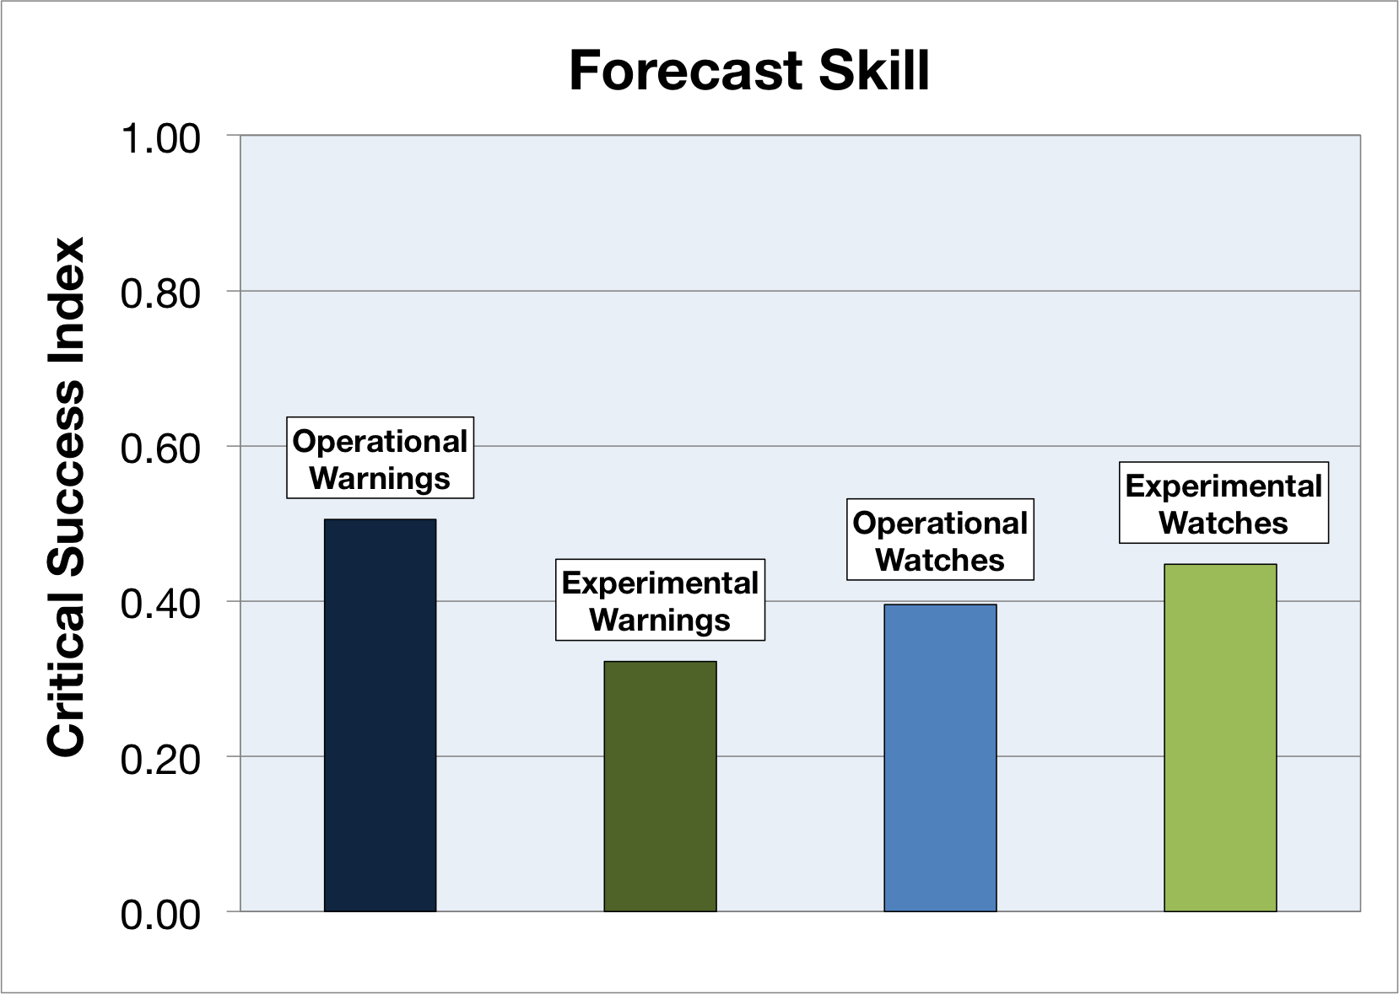
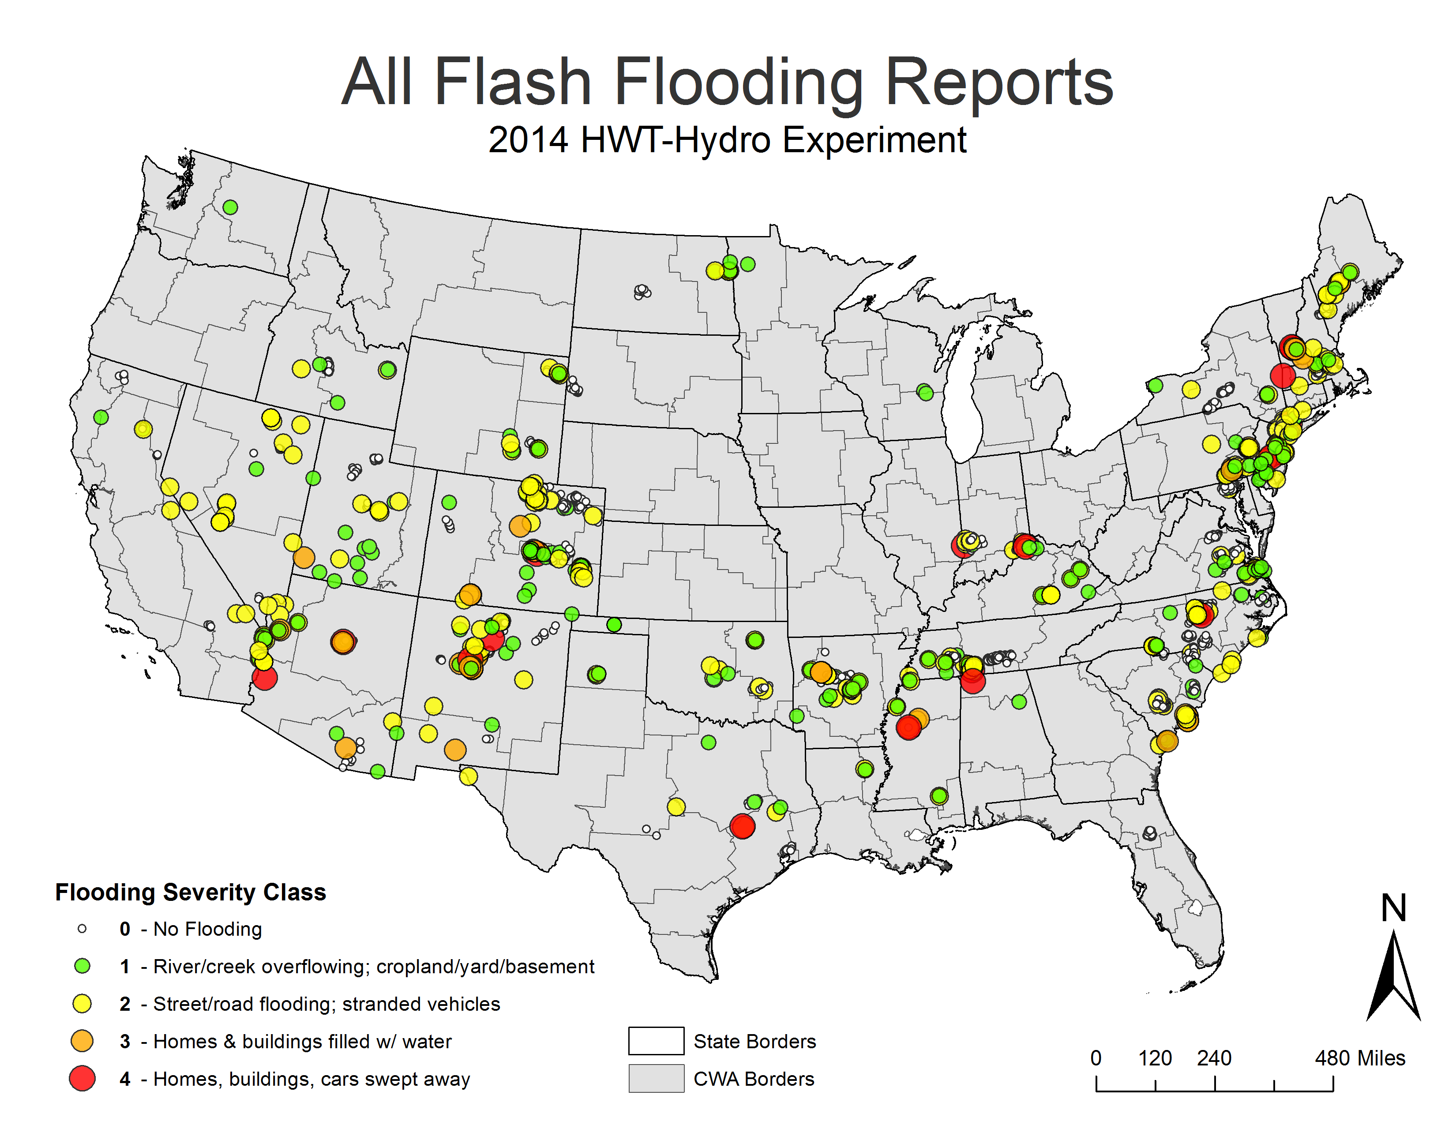
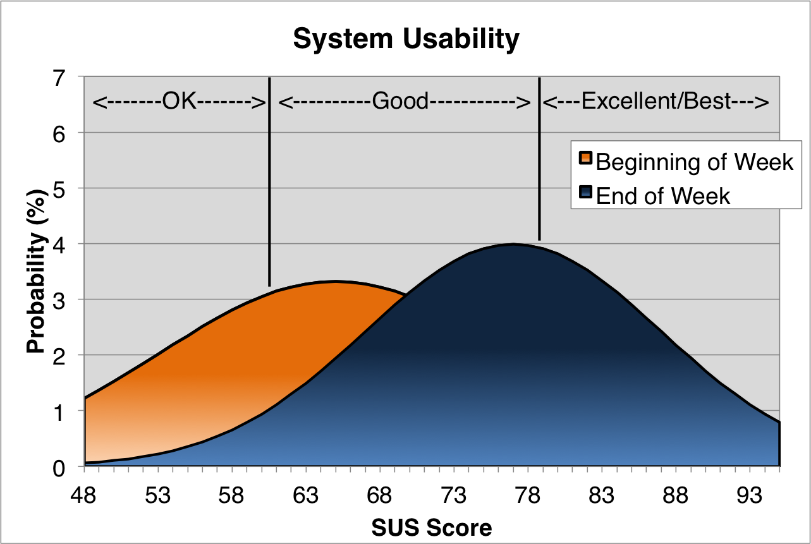
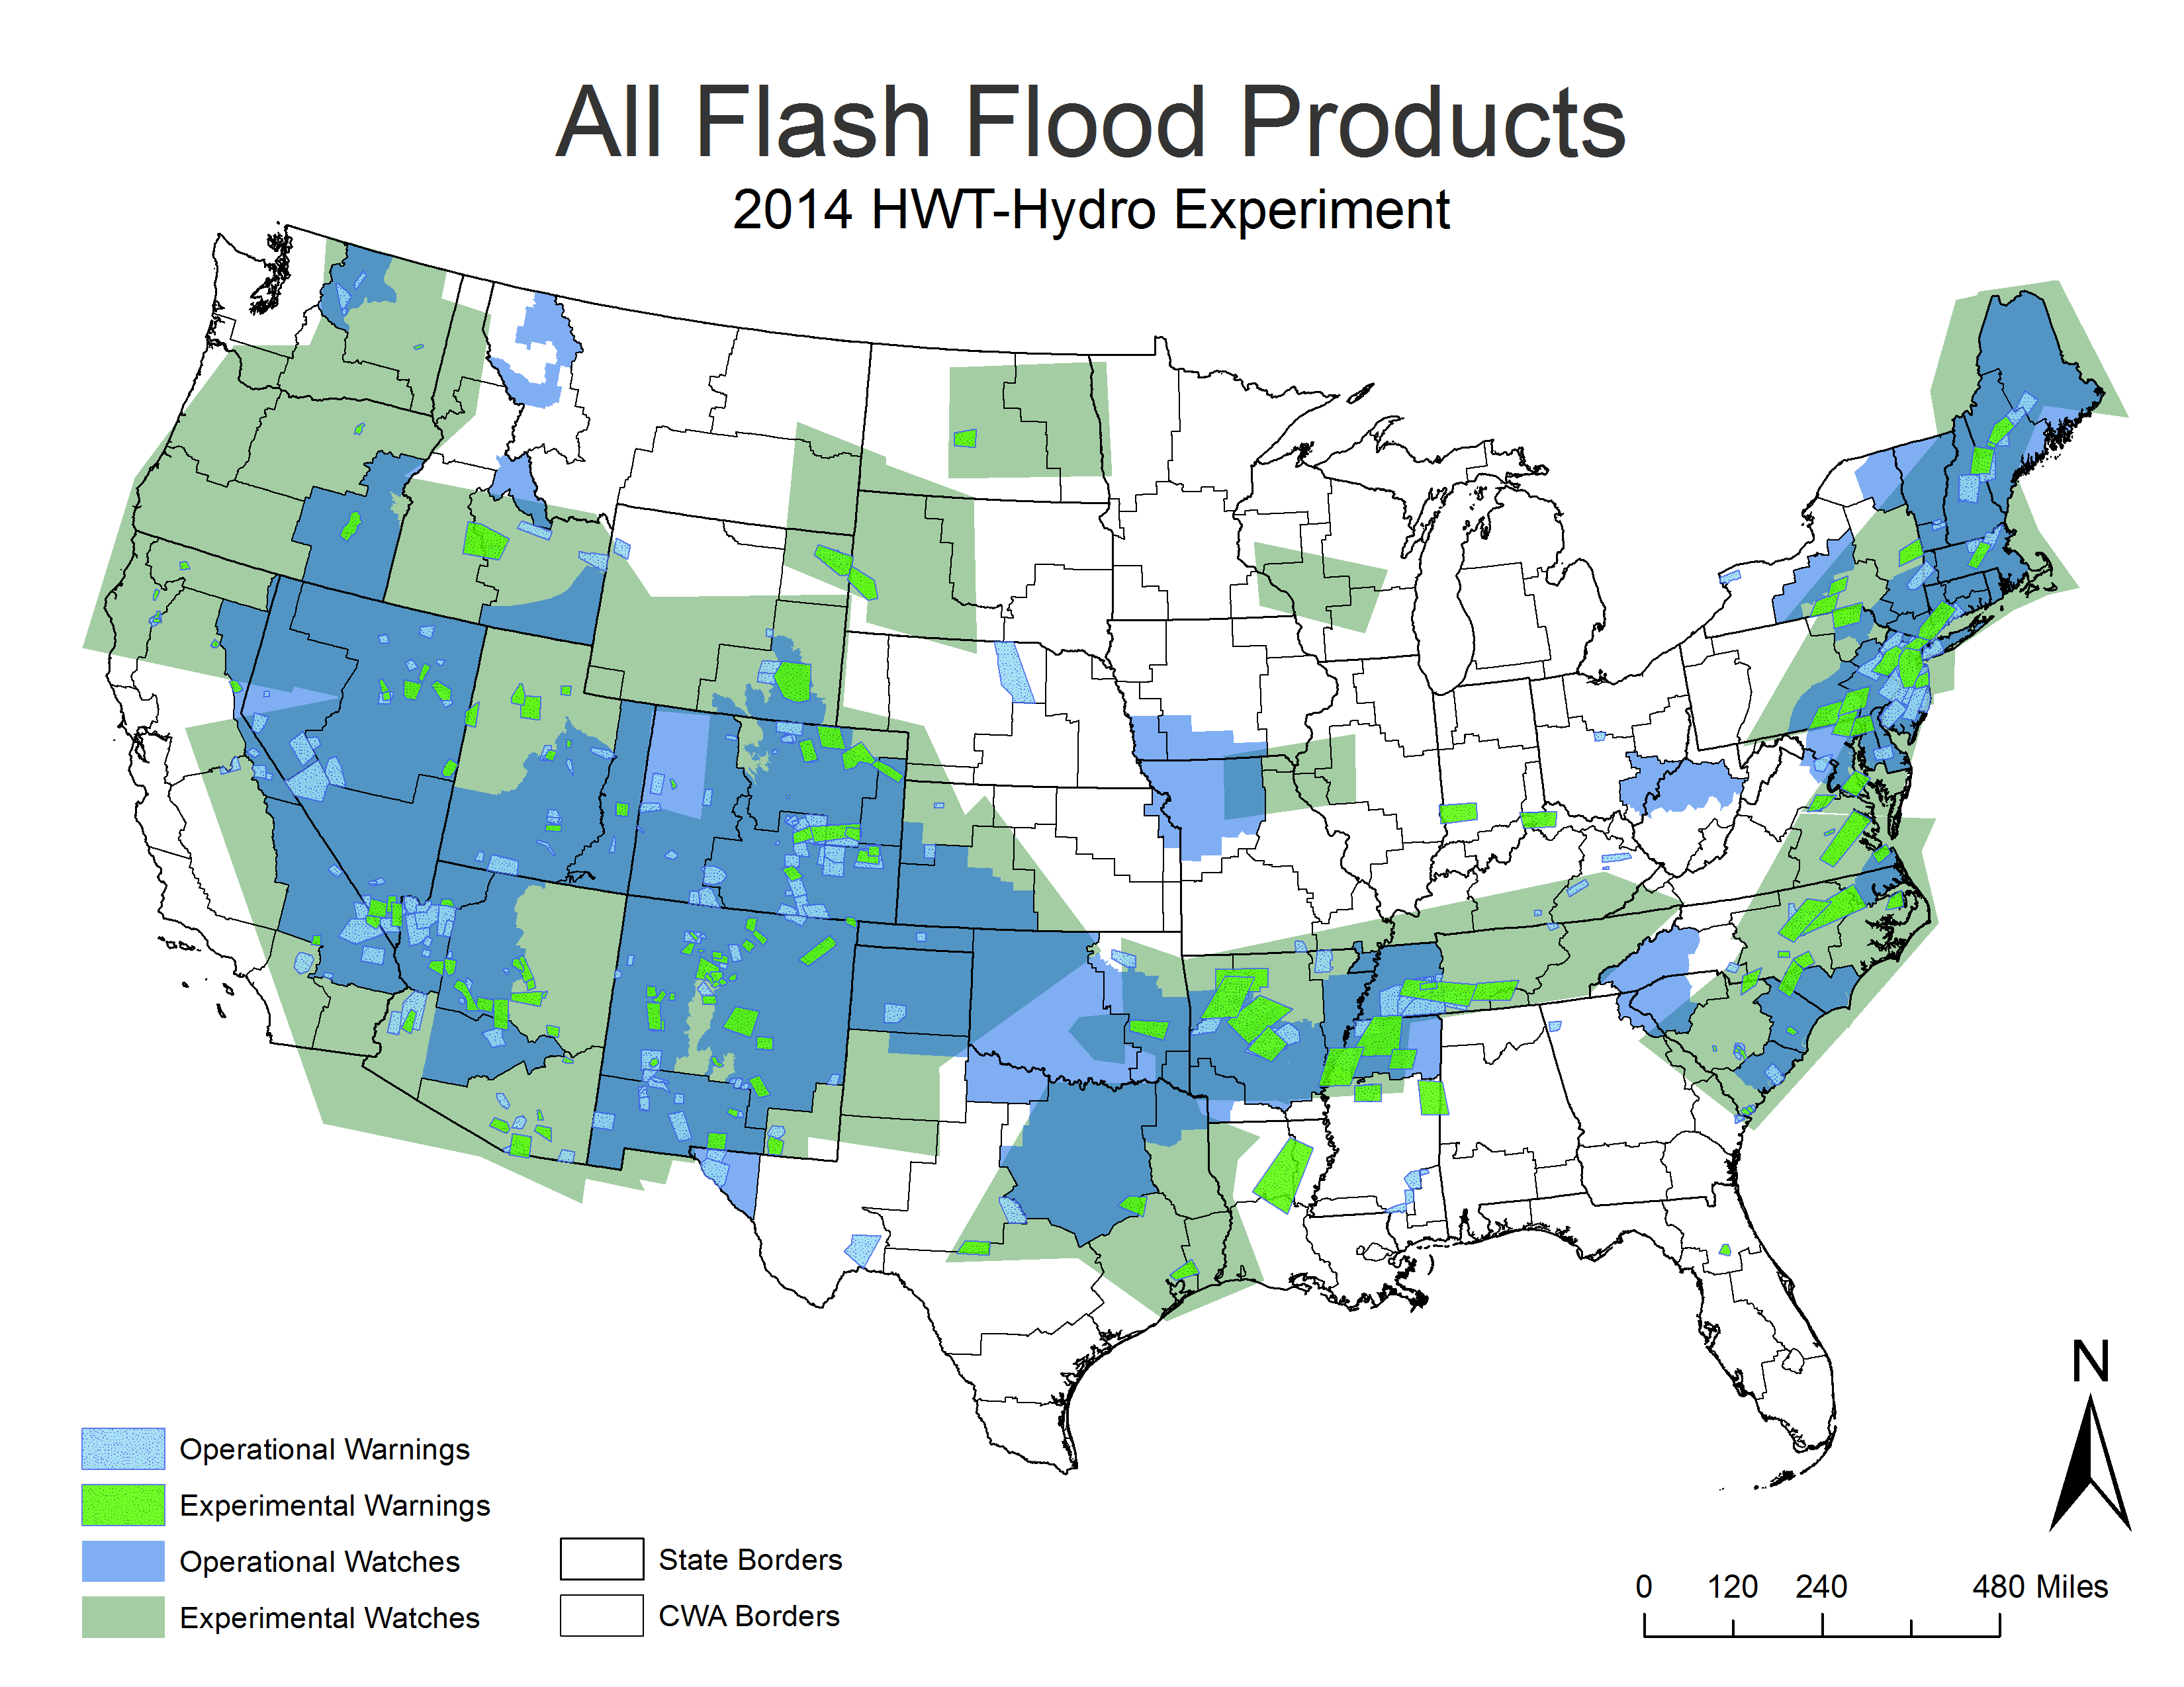
The 2014 Multi-Radar/Multi-Sensor (MRMS) HWT-Hydro Testbed Experiment
Brandon R. Smith^{1,3}, J.J. Gourley², Elizabeth Argyle^{1,3}, Race Clark III^{1,3}, Zac Flamig^{1,3}, Steve Martinaitis¹, Lans Rothfusz²
¹OU Cooperative Institute for Mesoscale Meteorological Studies, ²NOAA National Severe Storms Laboratory, ³University of Oklahoma
Experiment Activities
July 7 – August 1, 2014 in Norman, OK
Featured 17 NWS forecasters from across the U.S.
Issued experimental probabilistic flash flood watches and warnings with impact characterization
Utilized over 30+ experimental MRMS-Flooded Locations & Simulated Hydrographs (FLASH) tools (J.J. Gourley)
Coordinated daily with WPC’s FFaIR Testbed
Experiment Datasets
Experiment Results
Forecast Tools
Hydrologic models
Precipitable water
QPE/QPF
Flash flood guidance (FFG)
Precipitation return periods
Radar
Skill of experimental watches
comparable to operational
watches*
Skill of experimental warnings
less skillful than operational
warnings**
Observations
USGS Stream Gauges
Local Storm Reports
Storm Data
mPING (Kim Elmore)
SHAVE (Travis Smith)
Easy learning curve of FLASH system
Improved system usability after 1-week of use
Will help in creating a smooth transition to NWS operations
Main Goals of HWT-Hydro
Issue experimental FF watches between 0 – 6 hours before event & experimental FF warnings just prior to and during an event
Operate a near-real-time multi-source FF observation database
Subjective evaluation of all experimental observations, tools, and forecast products
Prepare FLASH tools for transition to NWS operations
Products
Operational Warnings
Experimental Warnings
Operational Watches
Experimental Watches
Suite of experimental tools increased forecaster confidence
Daily subjective evaluations of tools/products
‘Tails from the Testbed’ webinars
Forecasters liked assigning uncertainty and magnitude estimates to their watches/warnings (work needed to ensure reliability)
Notes:
Notes from dry-run:
1.) Talk ran about 7 minutes. Need to cut 2 minutes off. Find information to cut down on (maybe less detail about each point) (TALK LESS??).
2.) Link each image to a slide with a larger image (and maybe bullet points).
3.) Make a mock up of a two-slide presentation (one for each screen).
- Add example images of reports/warnings?
- Add photos of forecasters in action (admiral visit).
4.) Test out on Devlab displays.
5.) Talk to JJ about adding animation of FLASH.
6.) Add affiliations of each individual listed above.
7.) Remake products map (hard to tell difference between operational watches/warnings).

Slide 2
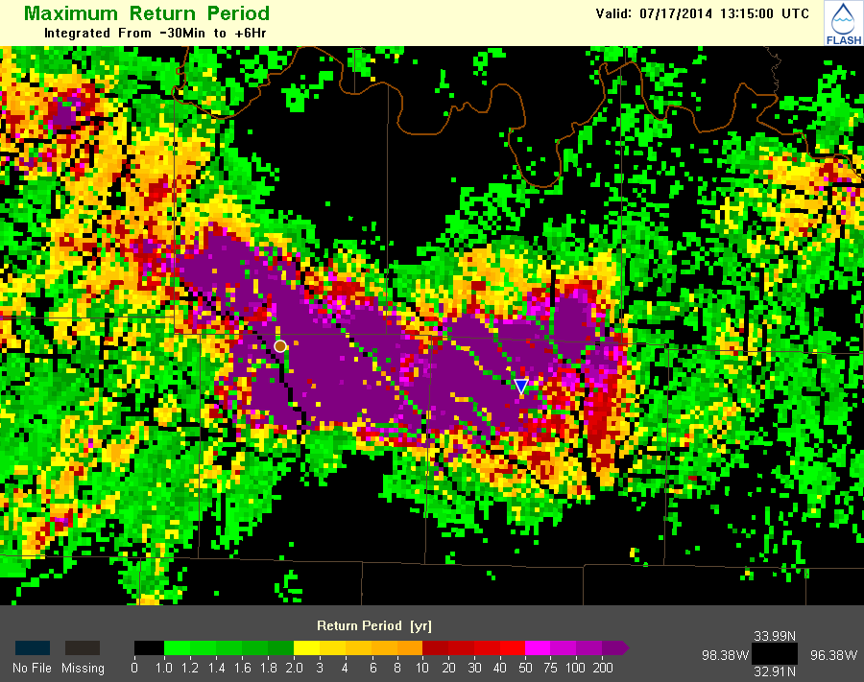
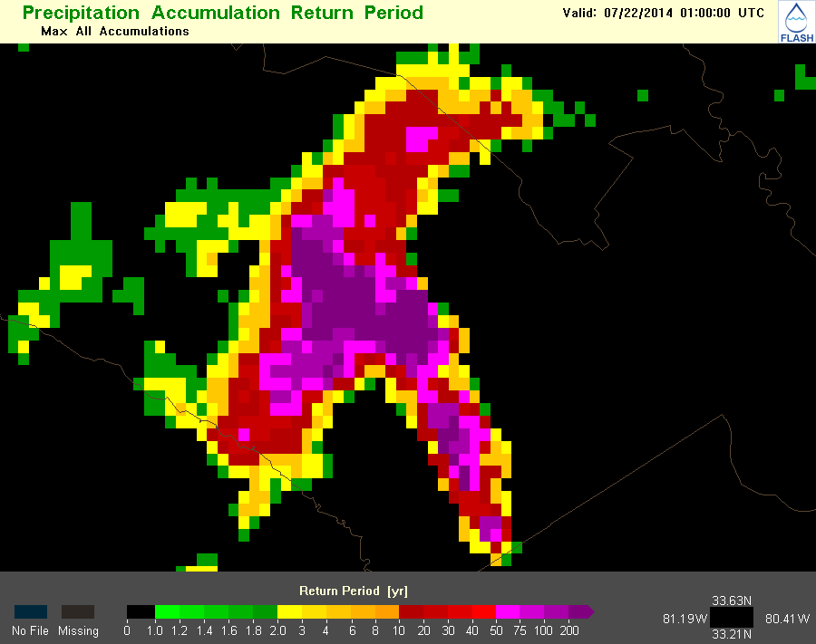
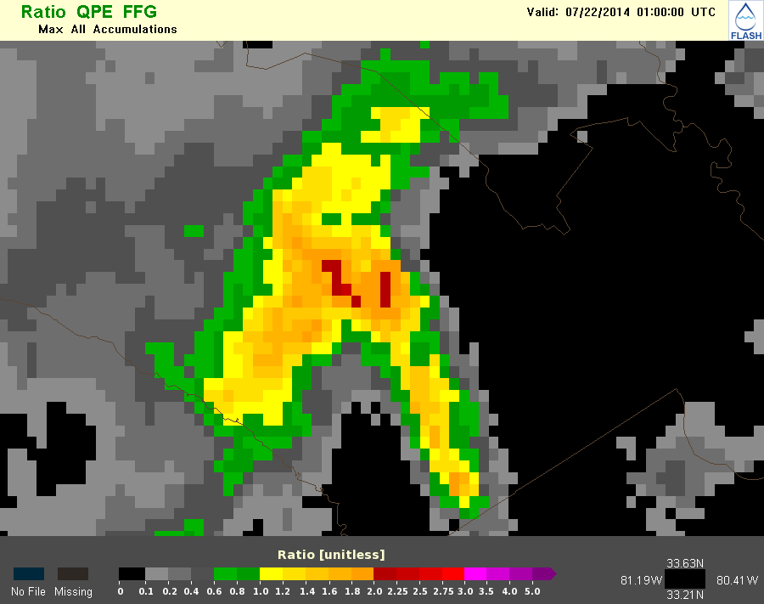
The 2014 Multi-Radar/Multi-Sensor (MRMS) HWT-Hydro Testbed Experiment
CREST Max. Return Period
FLASH Maximum Return Period
Brandon R. Smith, J.J. Gourley, Elizabeth Argyle, Race Clark III, Zac Flamig, Steve Martinaitis, Lans Rothfusz
Forecast Tools
Hydrologic models
Precipitable water
Quantitative Precipitation Estimate (QPE) /Quantitative Precipitation Forecast (QPF)
Flash Flood Guidance (FFG)
Precipitation Return Periods
Radar
Experiment Activities
July 7 – August 1, 2014 in Norman, OK
Featured 17 NWS forecasters from across the U.S.
Issued experimental probabilistic flash flood watches and warning with impact characterization
Utilized a suite of 30+ experimental MRMS-FLASH tools in AWIPS-II
Coordinated daily with WPC’s FFaIR Testbed
Main Goals of HWT-Hydro
Prepare FLASH tools for transition to NWS operations
Ingest, utilize a near-real-time multi-source FF observation database
Issue experimental FF watches between 0 – 6 hours before event & experimental FF warnings just prior to and during an event
Subjective evaluation of all experimental observations, tool, and forecast products
Experimental Datasets
Forecast Tools
Hydrologic models
Precipitable water
QPE/QPE
Flash flood guidance (FFG)
Precipitation return periods
Radar
Observations (Total: 606)
USGS Stream Gauges (9)
NWS Local Storm Reports (250)
NCDC Storm Data (184)
mPING reports (39)
SHAVE reports (124 – 1,130 null)
Products (Total: 519)
Operational FF Warnings (236)
Experimental FF Warnings (153)
Operational FF Watches (79)
Experimental FF Watches (51)
Experiment Results
Skill of experimental watches as
skillful or slightly more skillful
than operational watches*
Skill of experimental warnings
comparable or less skillful than
operational warnings**
Easy learning curve of FLASH system
Improved system usability after 1-week of use
Overall, positive participant feedback of experiment
Suite of experimental tools increased forecast confidence
Daily subjective evaluations of tools/products
‘Tails from the Testbed’ webinars
Forecasters liked assigned uncertainty and magnitude estimates to their watches/warnings (work needed to ensure reliability)
1
1
2
3
Notes:
Notes from dry-run:
1.) Talk ran about 7 minutes. Need to cut 2 minutes off. Find information to cut down on (maybe less detail about each point).
2.) Link each image to a slide with a larger image (and maybe bullet points).
3.) Make a mock up of a two-slide presentation (one for each screen).
4.) Test out on Devlab displays.
5.) Add photos of forecasters in action (admiral visit).
6.) Talk to JJ about adding animation of FLASH.
7.) Add example images of reports/warnings?
8.) Add affiliations of each individual listed above.

Slide 3
The 2014 Multi-Radar/Multi-Sensor (MRMS) HWT-Hydro Testbed Experiment
Max. Precip Return Period
FLASH Maximum Return Period
Brandon R. Smith, J.J. Gourley, Elizabeth Argyle, Race Clark III, Zac Flamig, Steve Martinaitis, Lans Rothfusz
Forecast Tools
Hydrologic models
Precipitable water
Quantitative Precipitation Estimate (QPE) /Quantitative Precipitation Forecast (QPF)
Flash Flood Guidance (FFG)
Precipitation Return Periods
Radar
Experiment Activities
July 7 – August 1, 2014 in Norman, OK
Featured 17 NWS forecasters from across the U.S.
Issued experimental probabilistic flash flood watches and warning with impact characterization
Utilized a suite of 30+ experimental MRMS-FLASH tools in AWIPS-II
Coordinated daily with WPC’s FFaIR Testbed
Main Goals of HWT-Hydro
Prepare FLASH tools for transition to NWS operations
Ingest, utilize a near-real-time multi-source FF observation database
Issue experimental FF watches between 0 – 6 hours before event & experimental FF warnings just prior to and during an event
Subjective evaluation of all experimental observations, tool, and forecast products
Experimental Datasets
Forecast Tools
Hydrologic models
Precipitable water
QPE/QPE
Flash flood guidance (FFG)
Precipitation return periods
Radar
Observations (Total: 606)
USGS Stream Gauges (9)
NWS Local Storm Reports (250)
NCDC Storm Data (184)
mPING reports (39)
SHAVE reports (124 – 1,130 null)
Products (Total: 519)
Operational FF Warnings (236)
Experimental FF Warnings (153)
Operational FF Watches (79)
Experimental FF Watches (51)
Experiment Results
Skill of experimental watches as
skillful or slightly more skillful
than operational watches*
Skill of experimental warnings
comparable or less skillful than
operational warnings**
Easy learning curve of FLASH system
Improved system usability after 1-week of use
Overall, positive participant feedback of experiment
Suite of experimental tools increased forecast confidence
Daily subjective evaluations of tools/products
‘Tails from the Testbed’ webinars
Forecasters liked assigned uncertainty and magnitude estimates to their watches/warnings (work needed to ensure reliability)
2
1
2
3
Notes:
Notes from dry-run:
1.) Talk ran about 7 minutes. Need to cut 2 minutes off. Find information to cut down on (maybe less detail about each point).
2.) Link each image to a slide with a larger image (and maybe bullet points).
3.) Make a mock up of a two-slide presentation (one for each screen).
4.) Test out on Devlab displays.
5.) Add photos of forecasters in action (admiral visit).
6.) Talk to JJ about adding animation of FLASH.
7.) Add example images of reports/warnings?
8.) Add affiliations of each individual listed above.

Slide 4
The 2014 Multi-Radar/Multi-Sensor (MRMS) HWT-Hydro Testbed Experiment
Max. MRMS QPE to FFG Ratio
FLASH Maximum Return Period
Brandon R. Smith, J.J. Gourley, Elizabeth Argyle, Race Clark III, Zac Flamig, Steve Martinaitis, Lans Rothfusz
Forecast Tools
Hydrologic models
Precipitable water
Quantitative Precipitation Estimate (QPE) /Quantitative Precipitation Forecast (QPF)
Flash Flood Guidance (FFG)
Precipitation Return Periods
Radar
Experiment Activities
July 7 – August 1, 2014 in Norman, OK
Featured 17 NWS forecasters from across the U.S.
Issued experimental probabilistic flash flood watches and warning with impact characterization
Utilized a suite of 30+ experimental MRMS-FLASH tools in AWIPS-II
Coordinated daily with WPC’s FFaIR Testbed
Main Goals of HWT-Hydro
Prepare FLASH tools for transition to NWS operations
Ingest, utilize a near-real-time multi-source FF observation database
Issue experimental FF watches between 0 – 6 hours before event & experimental FF warnings just prior to and during an event
Subjective evaluation of all experimental observations, tool, and forecast products
Experimental Datasets
Forecast Tools
Hydrologic models
Precipitable water
QPE/QPE
Flash flood guidance (FFG)
Precipitation return periods
Radar
Observations (Total: 606)
USGS Stream Gauges (9)
NWS Local Storm Reports (250)
NCDC Storm Data (184)
mPING reports (39)
SHAVE reports (124 – 1,130 null)
Products (Total: 519)
Operational FF Warnings (236)
Experimental FF Warnings (153)
Operational FF Watches (79)
Experimental FF Watches (51)
Experiment Results
Skill of experimental watches as
skillful or slightly more skillful
than operational watches*
Skill of experimental warnings
comparable or less skillful than
operational warnings**
Easy learning curve of FLASH system
Improved system usability after 1-week of use
Overall, positive participant feedback of experiment
Suite of experimental tools increased forecast confidence
Daily subjective evaluations of tools/products
‘Tails from the Testbed’ webinars
Forecasters liked assigned uncertainty and magnitude estimates to their watches/warnings (work needed to ensure reliability)
3
1
2
3
Notes:
Notes from dry-run:
1.) Talk ran about 7 minutes. Need to cut 2 minutes off. Find information to cut down on (maybe less detail about each point).
2.) Link each image to a slide with a larger image (and maybe bullet points).
3.) Make a mock up of a two-slide presentation (one for each screen).
4.) Test out on Devlab displays.
5.) Add photos of forecasters in action (admiral visit).
6.) Talk to JJ about adding animation of FLASH.
7.) Add example images of reports/warnings?
8.) Add affiliations of each individual listed above.

Slide 5
The 2014 Multi-Radar/Multi-Sensor (MRMS) HWT-Hydro Testbed Experiment
Brandon R. Smith, J.J. Gourley, Elizabeth Argyle, Race Clark III, Zac Flamig, Steve Martinaitis, Lans Rothfusz
Experiment Activities
July 7 – August 1, 2014 in Norman, OK
Featured 17 NWS forecasters from across the U.S.
Issued experimental probabilistic flash flood watches and warning with impact characterization
Utilized a suite of 30+ experimental MRMS-FLASH tools in AWIPS-II
Coordinated daily with WPC’s FFaIR Testbed
Main Goals of HWT-Hydro
Prepare FLASH tools for transition to NWS operations
Ingest, utilize a near-real-time multi-source FF observation database
Issue experimental FF watches between 0 – 6 hours before event & experimental FF warnings just prior to and during an event
Subjective evaluation of all experimental observations, tool, and forecast products
Experimental Datasets
Forecast Tools
Hydrologic models
Precipitable water
QPE/QPE
Flash flood guidance (FFG)
Precipitation return periods
Radar
Observations (Total: 606)
USGS Stream Gauges (9)
NWS Local Storm Reports (250)
NCDC Storm Data (184)
mPING reports (39)
SHAVE reports (124 – 1,130 null)
Products (Total: 519)
Operational FF Warnings (236)
Experimental FF Warnings (153)
Operational FF Watches (79)
Experimental FF Watches (51)
Experiment Results
Skill of experimental watches as
skillful or slightly more skillful
than operational watches*
Skill of experimental warnings
comparable or less skillful than
operational warnings**
Easy learning curve of FLASH system
Improved system usability after 1-week of use
Overall, positive participant feedback of experiment
Suite of experimental tools increased forecast confidence
Daily subjective evaluations of tools/products
‘Tails from the Testbed’ webinars
Forecasters liked assigned uncertainty and magnitude estimates to their watches/warnings (work needed to ensure reliability)
Observations (Total: 606)
USGS Stream Gauges (9)
NWS Local Storm Reports (250)
NCDC Storm Data (184)
mPING reports (39)
SHAVE reports (124 / 1,130 null)
Notes:
Notes from dry-run:
1.) Talk ran about 7 minutes. Need to cut 2 minutes off. Find information to cut down on (maybe less detail about each point).
2.) Link each image to a slide with a larger image (and maybe bullet points).
3.) Make a mock up of a two-slide presentation (one for each screen).
4.) Test out on Devlab displays.
5.) Add photos of forecasters in action (admiral visit).
6.) Talk to JJ about adding animation of FLASH.
7.) Add example images of reports/warnings?
8.) Add affiliations of each individual listed above.

Slide 6
The 2014 Multi-Radar/Multi-Sensor (MRMS) HWT-Hydro Testbed Experiment
Brandon R. Smith, J.J. Gourley, Elizabeth Argyle, Race Clark III, Zac Flamig, Steve Martinaitis, Lans Rothfusz
Experiment Activities
July 7 – August 1, 2014 in Norman, OK
Featured 17 NWS forecasters from across the U.S.
Issued experimental probabilistic flash flood watches and warning with impact characterization
Utilized a suite of 30+ experimental MRMS-FLASH tools in AWIPS-II
Coordinated daily with WPC’s FFaIR Testbed
Main Goals of HWT-Hydro
Prepare FLASH tools for transition to NWS operations
Ingest, utilize a near-real-time multi-source FF observation database
Issue experimental FF watches between 0 – 6 hours before event & experimental FF warnings just prior to and during an event
Subjective evaluation of all experimental observations, tool, and forecast products
Experimental Datasets
Forecast Tools
Hydrologic models
Precipitable water
QPE/QPE
Flash flood guidance (FFG)
Precipitation return periods
Radar
Observations (Total: 606)
USGS Stream Gauges (9)
NWS Local Storm Reports (250)
NCDC Storm Data (184)
mPING reports (39)
SHAVE reports (124 – 1,130 null)
Products (Total: 519)
Operational FF Warnings (236)
Experimental FF Warnings (153)
Operational FF Watches (79)
Experimental FF Watches (51)
Experiment Results
Skill of experimental watches as
skillful or slightly more skillful
than operational watches*
Skill of experimental warnings
comparable or less skillful than
operational warnings**
Easy learning curve of FLASH system
Improved system usability after 1-week of use
Overall, positive participant feedback of experiment
Suite of experimental tools increased forecast confidence
Daily subjective evaluations of tools/products
‘Tails from the Testbed’ webinars
Forecasters liked assigned uncertainty and magnitude estimates to their watches/warnings (work needed to ensure reliability)
Products (Total: 519)
Operational FF Warnings (236)
Experimental FF Warnings (153)
Operational FF Watches (79)
Experimental FF Watches (51)
Notes:
Notes from dry-run:
1.) Talk ran about 7 minutes. Need to cut 2 minutes off. Find information to cut down on (maybe less detail about each point).
2.) Link each image to a slide with a larger image (and maybe bullet points).
3.) Make a mock up of a two-slide presentation (one for each screen).
4.) Test out on Devlab displays.
5.) Add photos of forecasters in action (admiral visit).
6.) Talk to JJ about adding animation of FLASH.
7.) Add example images of reports/warnings?
8.) Add affiliations of each individual listed above.

Slide 7
The 2014 Multi-Radar/Multi-Sensor (MRMS) HWT-Hydro Testbed Experiment
Brandon R. Smith, J.J. Gourley, Elizabeth Argyle, Race Clark III, Zac Flamig, Steve Martinaitis, Lans Rothfusz
Skill of experimental watches comparable to operational watches*
Large watch sizes might skew the results
Skill of experimental warnings less skillful than operational warnings**
Not a factor of the experimental tools
Combination of report availability & lack of local knowledge
Experiment Activities
July 7 – August 1, 2014 in Norman, OK
Featured 17 NWS forecasters from across the U.S.
Issued experimental probabilistic flash flood watches and warning with impact characterization
Utilized a suite of 30+ experimental MRMS-FLASH tools in AWIPS-II
Coordinated daily with WPC’s FFaIR Testbed
Main Goals of HWT-Hydro
Prepare FLASH tools for transition to NWS operations
Ingest, utilize a near-real-time multi-source FF observation database
Issue experimental FF watches between 0 – 6 hours before event & experimental FF warnings just prior to and during an event
Subjective evaluation of all experimental observations, tool, and forecast products
Experimental Datasets
Forecast Tools
Hydrologic models
Precipitable water
QPE/QPE
Flash flood guidance (FFG)
Precipitation return periods
Radar
Observations (Total: 606)
USGS Stream Gauges (9)
NWS Local Storm Reports (250)
NCDC Storm Data (184)
mPING reports (39)
SHAVE reports (124 – 1,130 null)
Products (Total: 519)
Operational FF Warnings (236)
Experimental FF Warnings (153)
Operational FF Watches (79)
Experimental FF Watches (51)
Experiment Results
Skill of experimental watches as
skillful or slightly more skillful
than operational watches*
Skill of experimental warnings
comparable or less skillful than
operational warnings**
Easy learning curve of FLASH system
Improved system usability after 1-week of use
Overall, positive participant feedback of experiment
Suite of experimental tools increased forecast confidence
Daily subjective evaluations of tools/products
‘Tails from the Testbed’ webinars
Forecasters liked assigned uncertainty and magnitude estimates to their watches/warnings (work needed to ensure reliability)
Notes:
Notes from dry-run:
1.) Talk ran about 7 minutes. Need to cut 2 minutes off. Find information to cut down on (maybe less detail about each point).
2.) Link each image to a slide with a larger image (and maybe bullet points).
3.) Make a mock up of a two-slide presentation (one for each screen).
4.) Test out on Devlab displays.
5.) Add photos of forecasters in action (admiral visit).
6.) Talk to JJ about adding animation of FLASH.
7.) Add example images of reports/warnings?
8.) Add affiliations of each individual listed above.

Slide 8
The 2014 Multi-Radar/Multi-Sensor (MRMS) HWT-Hydro Testbed Experiment
Brandon R. Smith, J.J. Gourley, Elizabeth Argyle, Race Clark III, Zac Flamig, Steve Martinaitis, Lans Rothfusz
Experiment Activities
July 7 – August 1, 2014 in Norman, OK
Featured 17 NWS forecasters from across the U.S.
Issued experimental probabilistic flash flood watches and warning with impact characterization
Utilized a suite of 30+ experimental MRMS-FLASH tools in AWIPS-II
Coordinated daily with WPC’s FFaIR Testbed
Main Goals of HWT-Hydro
Prepare FLASH tools for transition to NWS operations
Ingest, utilize a near-real-time multi-source FF observation database
Issue experimental FF watches between 0 – 6 hours before event & experimental FF warnings just prior to and during an event
Subjective evaluation of all experimental observations, tool, and forecast products
Experimental Datasets
Forecast Tools
Hydrologic models
Precipitable water
QPE/QPE
Flash flood guidance (FFG)
Precipitation return periods
Radar
Observations (Total: 606)
USGS Stream Gauges (9)
NWS Local Storm Reports (250)
NCDC Storm Data (184)
mPING reports (39)
SHAVE reports (124 – 1,130 null)
Products (Total: 519)
Operational FF Warnings (236)
Experimental FF Warnings (153)
Operational FF Watches (79)
Experimental FF Watches (51)
Experiment Results
Skill of experimental watches as
skillful or slightly more skillful
than operational watches*
Skill of experimental warnings
comparable or less skillful than
operational warnings**
Easy learning curve of FLASH system
Improved system usability after 1-week of use
Overall, positive participant feedback of experiment
Suite of experimental tools increased forecast confidence
Daily subjective evaluations of tools/products
‘Tails from the Testbed’ webinars
Forecasters liked assigned uncertainty and magnitude estimates to their watches/warnings (work needed to ensure reliability)
Easy learning curve of FLASH system
Improved system usability after 1-week of use
Will help in creating a smooth transition to NWS operations
Notes:
Notes from dry-run:
1.) Talk ran about 7 minutes. Need to cut 2 minutes off. Find information to cut down on (maybe less detail about each point).
2.) Link each image to a slide with a larger image (and maybe bullet points).
3.) Make a mock up of a two-slide presentation (one for each screen).
4.) Test out on Devlab displays.
5.) Add photos of forecasters in action (admiral visit).
6.) Talk to JJ about adding animation of FLASH.
7.) Add example images of reports/warnings?
8.) Add affiliations of each individual listed above.

