Slide 1
Using Bragg Scattering for ZDR calibration
V. Melnikov (CIMMS) and D. Zrnic (NSSL)
February 25–27, 2015
National Weather Center
Norman, Oklahoma

Slide 2
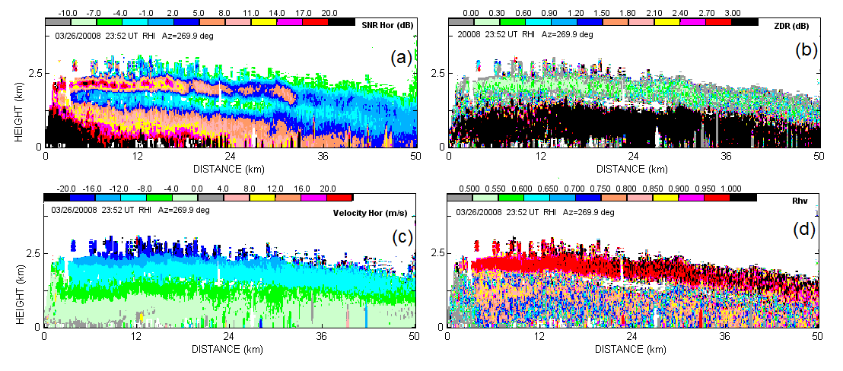
The WSR-88D radars are used to measure the rain and snowfall rates
ZDR Calibration using Bragg Scatter
Bragg scatter is reflection of radar waves from turbulent atmospheric eddies with sizes of about 5 cm (at the radar wavelength of 10 cm). No rain should be present in the radar volume, i.e., this is reflection from clear air.
Radar reflectivity (Z) and differential reflectivity (ZDR) are used to measure the rain rate (R): R = R(Z, ZDR)
To measure rain rate R (mm/h) with an accuracy of 10%, Z and ZDR should be measured with accuracies of 1 and 0.1 dB (3%) respectively.
The measurements of snowfall rates also requires ZDR accuracy of 0.1 dB (3%).
To verify ZDR calibration on the WSR-88D network, drizzle and light rain are currently used. Due to natural variability in the drop size distribution, this method allows verifying ZDR with accuracy of ±0.2 dB.
Is it possible to achieve accuracy of ±0.1 dB in calibrating ZDR?
Bragg Scatter layer
2-mm raindrop, ZDR = 0.5 dB
Insects
Vertical cross section of (a) reflectivity, (b) ZDR, (c) Doppler velocity, and (d) correlation coefficient. WSR-88D KOUN 03/05/2008 at 2052 UTC.
The small air eddies (sizes of about 5 cm), that cause Bragg scatter, are isotropic scatterers therefore intrinsic ZDR is 0 dB, i.e., the received powers in the horizontal and vertical radar channels are equal. This can be used to calibrate ZDR.

Slide 3
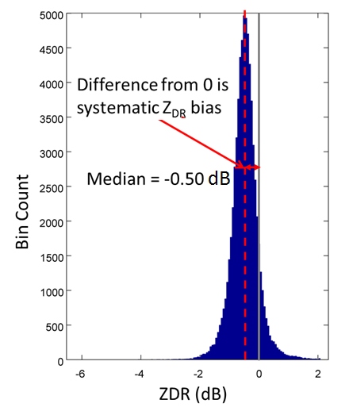
Summary
Implementation of the method on the WSR-88D network
Because intrinsic ZDR in Bragg scatter is 0 dB, it is possible to calibrate radar ZDR using Bragg scatter echoes. Deviation of measured ZDR from 0 dB indicates the measurement bias in radar. This bias must be accounted for in ZDR measurements.
Bragg scatter allows calibrating ZDR with accuracy of ±0.1 dB (3%).
The method is being implemented on the WSR-88D radar network.
The method will be operational on the NWS radar network in 2016.
Distribution of measured ZDR in Bragg echo, WSR-88D KRAX, Raleigh, NC, Sep. 2013. Obtained system ZDR bias is -0.50 dB
Time series of system ZDR bias in WSR-88D KTLX, OKC, OK, 2013. ZDR is biased negative most of the time.
Perspectives
Bragg scatter can be used to obtain the top of the convective boundary layer, i.e., to monitor the intensity of convection.

