Slide 1
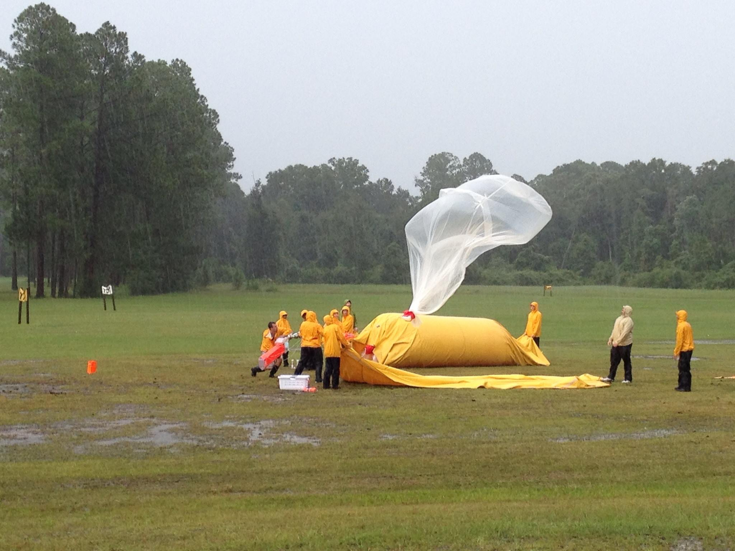
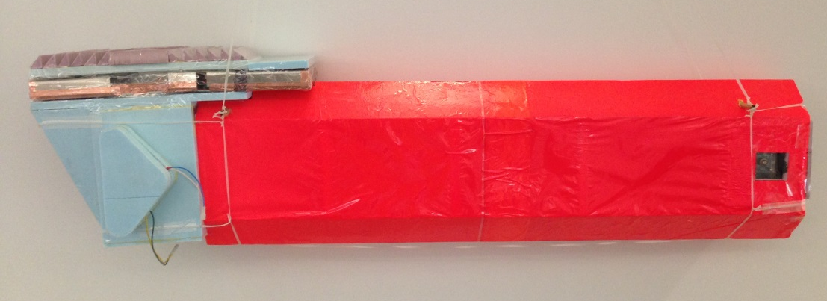
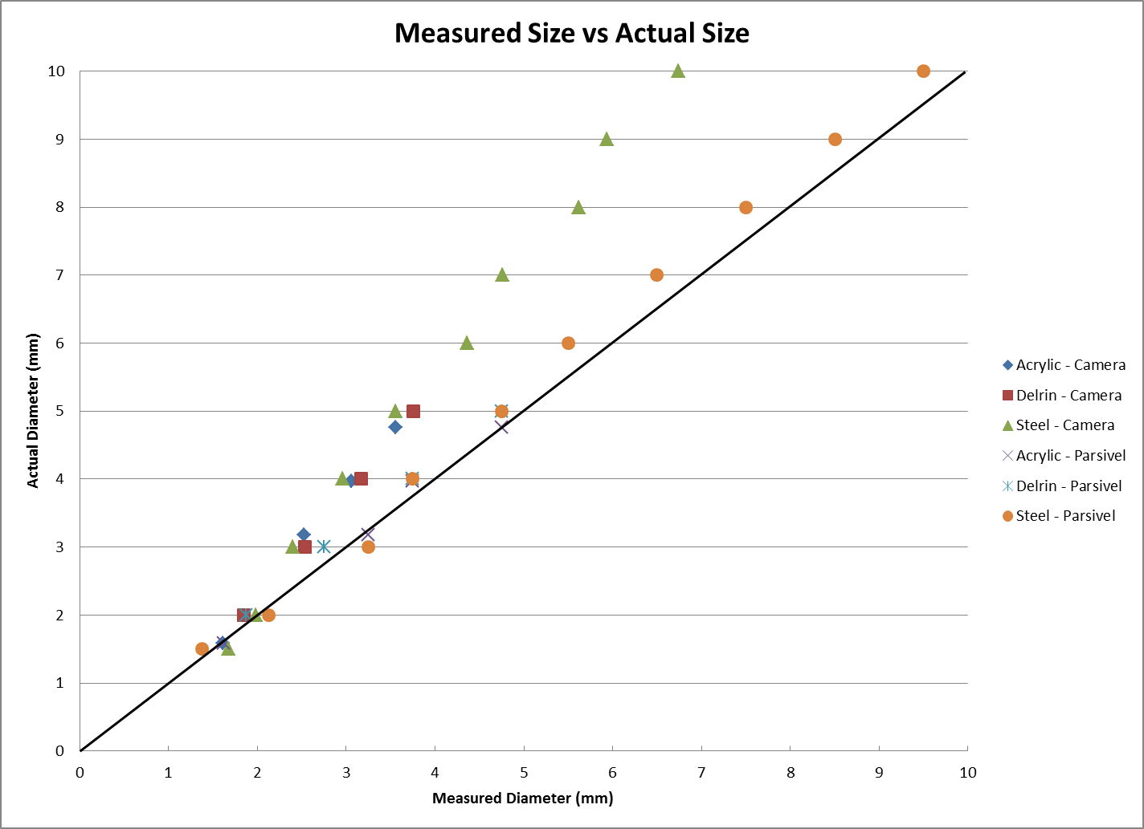
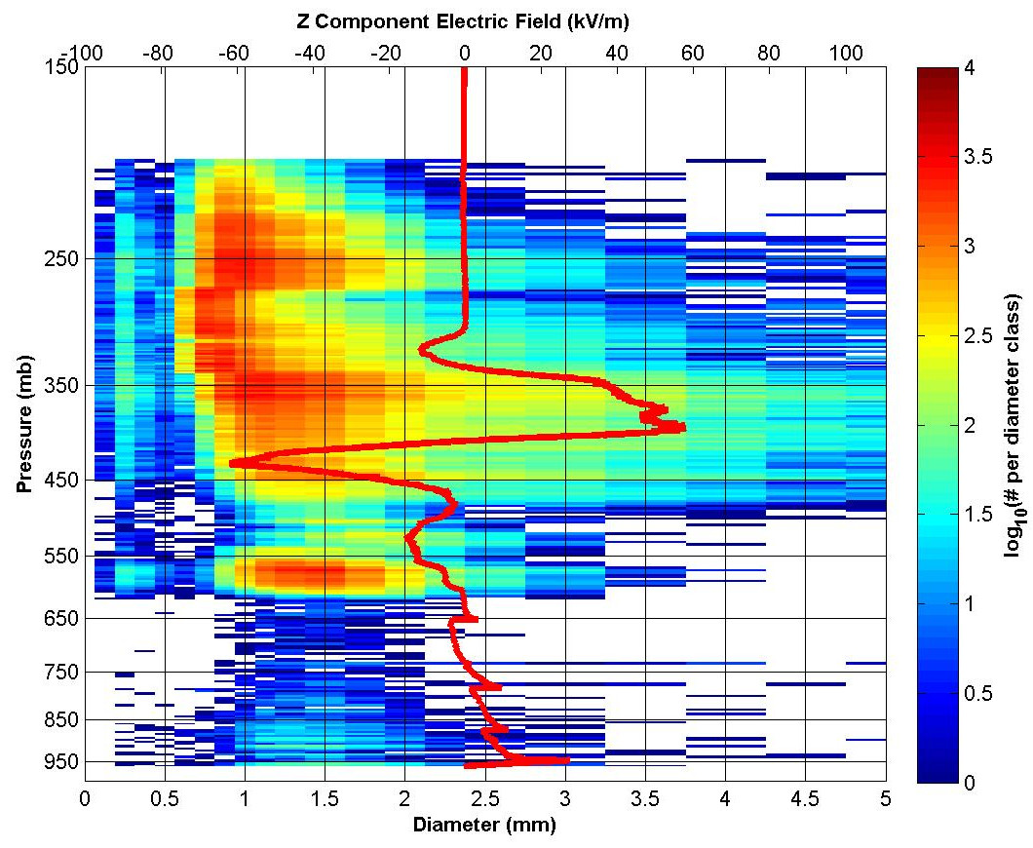
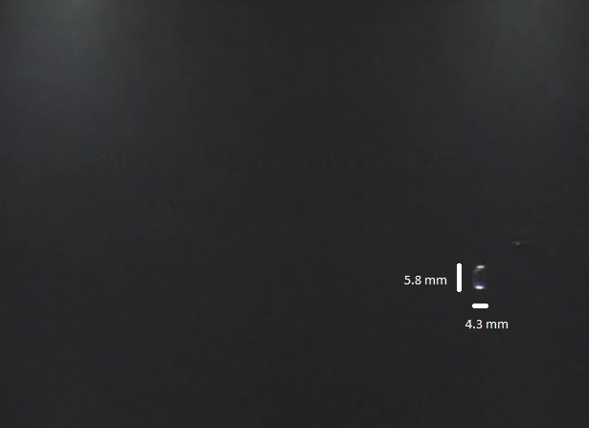
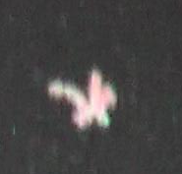

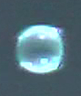
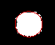
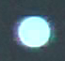
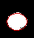
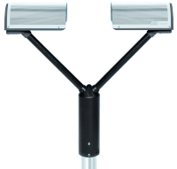
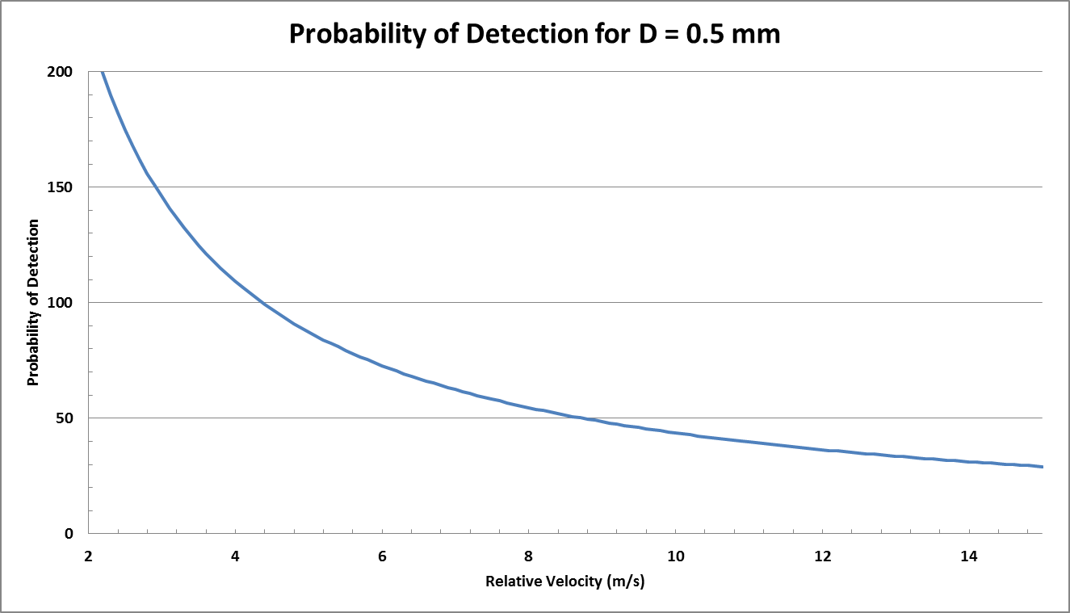
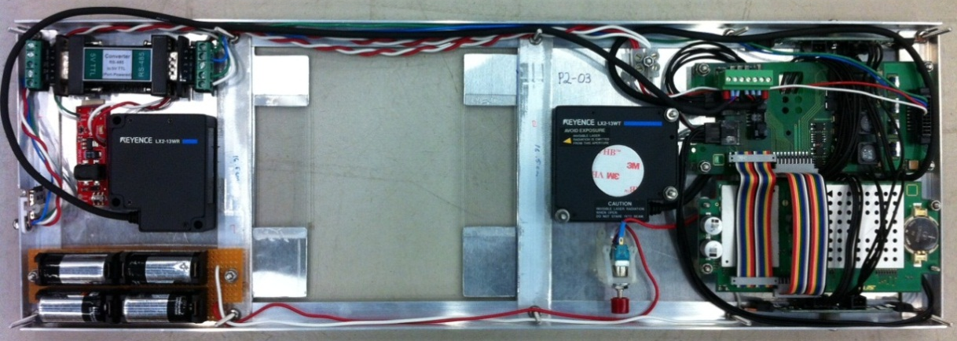
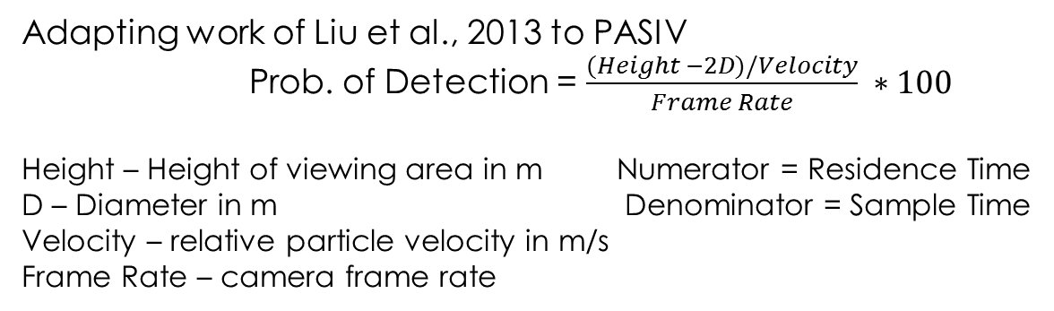
Videosondes
PArticle Size, Image, and Velocity (PASIV) Probe
List of Operation days
Location | Storm Type
May 29th, 2012 – C. OK | Supercell
June 21st, 2012 – C. OK | Multicell
August 15th, 2013 - FL | Weak single cell
August 16th, 2013 - FL | Stratiform
Nov 24th, 2013 – C. OK | Winter Storm
Jul 25th, 2013 – FL | Single cell
August 8th, 2014 – FL | Convective Line
Left: PASIV balloon launch on August 1, 2013 in FL during DARPA project.
Particle Direction
Sean Waugh
PARSIVEL
HD Video Camera
Specifications:
Dual Instrument System:
HD Camera
PARSIVEL Laser Distrometer
~5.5lbs total weight
Validate sizing accuracy of Camera and Parsivel
Test Objects over diameter range:
Acrylic Ball Bearing -> “Rain-like”
Delrin Ball Bearing -> “Graupel-like”
LED Batteries/Lights
HD Camera System:
Model HDC-SD9P
1920x1080 Resolution
1/8000 shutter speed
24 fps
Equivalent sample of 0.3% of each
second
Of Detected Particles, can provide:
Effective radius
Eccentricity
Thermodynamic profile of particle regions (with radiosonde)
Particle Type (i.e. rain, snow, graupel, etc.)
Crystal Habit (plates, columns, aggregates, etc.)
6.73 mm
4.3 mm
6.33 mm
5.8 mm
Can use relationship to
correct measured PSD
Rain
Aggregate
4.76 mm Diameter Acrylic
3 mm Diameter Delrin
Raw Image
Imager Analysis
Raw Image
Imager Analysis
June 21st, 2012 analyzed PSD sounding with overlaid electric field profile. Comparison indicates correlations between electric field strength and sign with particle distributions.
PARSIVEL 2 Laser Distrometer
Above: Video segments from indicated operation days.
Specifications:
780 nm Laser
10 sec data interval
Available data:
  Particle Count
  DSD
  Velocity Distribution
If velocity of particle known can correct sampled PSD
Conclusions:
One-of-a-kind instrument
In-house design
Hybrid system for increased confidence and accuracy
Capable of in situ particle data in under sampled locations of severe weather
  Several Applications
  Storm Electrification (when paired with Electric Field data)
  Dual-Pol Radar validation
  Cloud microphysical research
Above: Unmodified PARSIVEL 2 laser distrometer
Right: Condensed PARSIVEL-2 unit. Data stored locally on micro SD card. Approximately 6 hr battery life.
Adapting work of Liu et al., 2013 to PASIV
Prob. of Detection = $\frac{(Height −2D)/Velocity}{Frame Rate} ∗100$
Height – Height of viewing area in m Numerator = Residence Time
D – Diameter in m Denominator = Sample Time
Velocity – relative particle velocity in m/s
Frame Rate – camera frame rate

